Slide 1
A family-run business, employing over 250 staff worldwide, including internationally recognised subject matter experts
Over 2 million people are trained every year using Highfield products
Over 20,000 trainers and approved centres deliver Highfield qualifications
A client list comprising the world’s most recognisable organisations in their field
Internationally recognised accredited qualifications.

Slide 2
Why use MARKHOR?
Everything we do centres around our core values of:
quality - leading international industry experts from all fields, with supporting training materials available from Highfield
value - we will not be beaten on value. We concentrate on the areas important to our clients, including dedicated customer support, exceptional supporting documentation and unbeatable service and turnaround times
service - we provide all of our centres with their own dedicated account manager and have a turnaround time of 4 working days for results and certification
integrity - we provide our centres with accurate and honest information at all times - we never put profit before good advice.

Slide 3
Ground rules
Fire escapes
Toilets
Smoking
Drinks
Breaks
Lunch
Questions
Talking over others
Respect others’ points of view
Timekeeping
As a courtesy to others, please set your mobile phone to SILENT MODE
Mobile phones must be SWITCHED OFF and removed from the desk during the examination.
Notes:
This can be made interactive by encouraging delegates to suggest ground rules.
Examples may include:
confidentiality/anonymity or at least not mentioning names
being open
participating

Slide 4
Key
Class question
Individual exercise
Key point
KEY POINT
Law
Group exercise
Class exercise
CE
Definition
Key task
Navigation
Key Task
Notes:
The above symbols are primarily for tutors so that you know when a class question or exercise may be appropriate.

Slide 5
Module guide
1
Module 1: Principles of working in the private security industry
2
Module 2: Principles of working as a door supervisor in the private security industry
3
Module 3: Application of conflict management in the private security industry
Notes:
This training presentation includes module 1: Principles of working in the private security industry.
Module 2: Principles of working as a door supervisor in the private security industry and Module 3: Application of conflict management in the private security industry are provided as 2 separate training presentations included in this training package (3 training presentations in total).

Slide 6
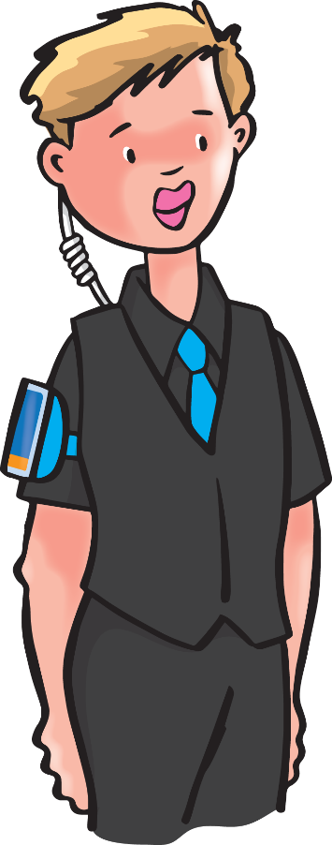
1
Principles of working in the private security industry
Notes:
This module covers:
the private security industry
legislation
arrest procedures
safe working practices
fire procedures
Emergencies
communication skills
record-keeping
terror threats
vulnerable people
post-incident management

Slide 7
Learning outcomes
This module covers:
1:1
the private security industry
1:7
communication skills
1:2
legislation
1:8
record-keeping
1:3
arrest procedures
1:9
terror threats
1:4
safe working practices
1:10
vulnerable people
1:11
post-incident management.
1:5
fire procedures
1:6
emergencies
Notes:
11 modules in total
Comprehensive tutor notes
Class discussion topics and class questions
Key tasks at the end of each module should be answered by all learners simultaneously to ensure everyone understands before moving to the next module.

Slide 8
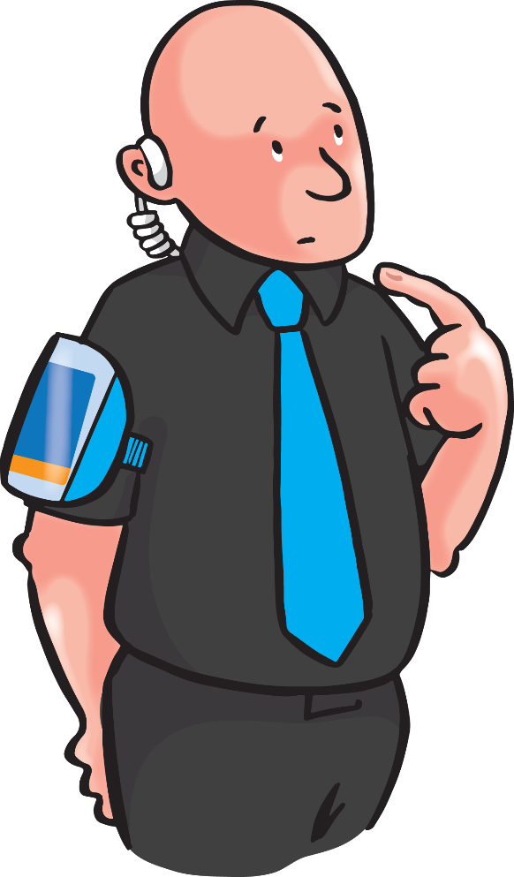
1:1
The private security industry
Notes:
Completion of this module will enable learners to meet the following learning outcome:
Learning outcome 1: Know the main characteristics and purposes of the Private Security Industry
This includes assessment criteria:
1.1 Identify the key purposes of the private security industry
1.2 State the aims and functions of the Security Industry Authority (SIA)
1.3 Recognise the required standards of behaviour of a security operative
1.4 Identify the benefits of community safety initiatives
1.5 Recognise how assignment instructions support the Security Operative role
1.6 Recognise how each security operative role may use CCTV
1.7 Identify the limitations of CCTV within the security operative role
1.8 State the purpose of the Approved Contractor Scheme
This module includes the following interactive activities:
class question: What is security?
class question: What qualities do you think security operatives should posses?
class question: What are the legal implications of using CCTV?
Key task 1

Slide 9
What is security?
Security is a state or feeling of being safe and secure
‘providing services to protect premises, people and their property’.
Notes:
Class question: What is security?
Click to reveal the answer.
The security industry is required to be regulated due to unscrupulous companies and criminal gangs forcing themselves upon businesses.
911 also had an impact as countries worldwide examined their security vetting procedures to prevent terrorists and other unauthorised people being able to carry out such a devastating act again.
The Private Security Act 2001 was not implemented until 1 January 2003 on a roll-out basis across the UK, starting with London. It was implemented into all areas of the UK by 1 January 2004.

Slide 10
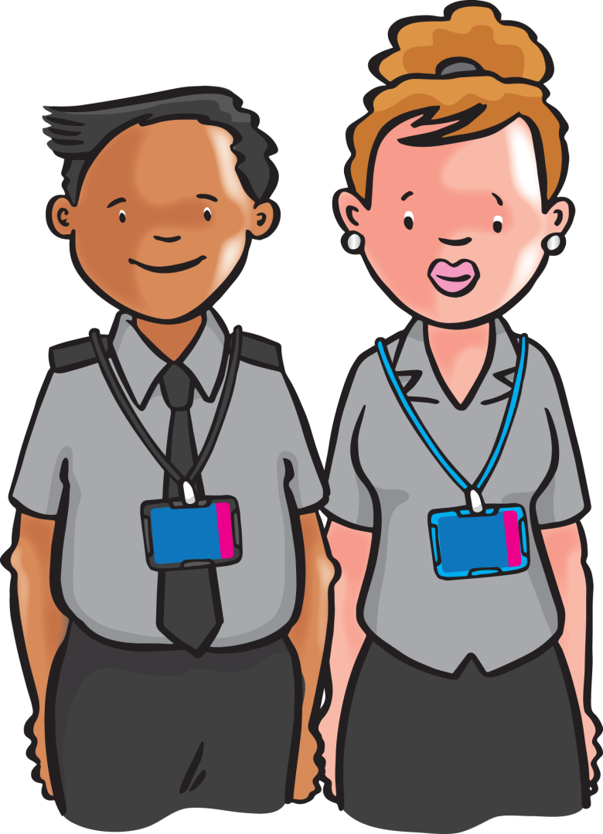
Main aims of security
Prevent and detect crime
Prevent or reduce loss, waste and damage
Monitor and respond to safety risks.
Notes:
Prevent by visual deterrent and detect crime through observation and possibly coordination with CCTV operative.
Prevent and reduce loss via monitoring staff and customers to reduce theft. Turning off lights etc. reduces waste.
Knowing how and responding appropriately to safety risks.

Slide 11
Security provision
Security can be provided to clients in 3 main ways:
manned security
physical security
systems.
Notes:
Security can be provided to clients in 3 main ways:
manned security – where 1 or more security operatives (male or female) work on a site, providing both a deterrent against crime and an immediate response to incidents as they occur
physical security – physical deterrents such as locks, alarms, barriers and grills to help reduce crime
systems – electronic and other technical systems to monitor premises for crime and other dangers such as intruder alarms, fire detection systems and closed-circuit television (CCTV) systems
Some systems are a combination of physical security and systems e.g. an intercom with image and magnet lock.

Slide 12
SIA
The SIA has 3 main aims:
the compulsory licensing of individuals undertaking designated activities within the private security industry
to recognise quality service by managing the voluntary Approved Contractor Scheme (ACS)
to introduce business licensing for all regulated security companies.
Notes:
This is a good point at which to mention the Private Security Act 2001 http://www.legislation.gov.uk/ukpga/2001/12/contents. This is covered in more detail later.
Directly employed CCTV and security officers (guards) are not regulated by the SIA.
ACS is a voluntary scheme that companies pay for. It is an accreditation from the SIA, stating that all procedures, including record-keeping, meet or exceed the SIA standards. These companies do not need to wait for an SIA licence to arrive prior to employing a security officer. They are allowed 10% of their employees to be in the process of being licensed by the SIA for up to 16 weeks.
Business licensing will standardise company record-keeping and insurance. There is currently no date for implementation of this scheme (January 2020).

Slide 13
Approved Contractor Scheme (ACS)
Designed to raise standards of security companies
These companies will assist the SIA with developing new opportunities
Increases customer confidence in the private security industry.
Notes:
The ACS introduced both operational and performance standards for private security companies.
Only companies that can prove they can meet the ACSs high standards will be awarded ‘Approved Contractor’ status.

Slide 14
SIA
The SIAs main functions are to:
protect the public by regulating the industry through licensing
raise standards
introduce business licensing for all regulated security businesses
monitor the activities and effectiveness of those working in the industry
set and approve standards of conduct, training and supervision within the industry
keep under review the private security industry and the operation of the legislative framework
increase customer confidence.
Notes:
The SIA’s main functions are to:
protect the public and regulate the security industry through licensing
raise standards (through the Approved Contractor Scheme)
introduce business licensing for all regulated security business
monitor the activities and effectiveness of those working in the industry
set and approve standards of conduct, training and supervision within the industry
keep under review the private security industry and the operation of the legislative framework
increase customer confidence

Slide 15
Individual licensing
The SIA currently licenses:
door supervisors
security officers (guarding/key holding)
cash and valuables in transit operatives
CCTV operators
close protection operatives
You MUST have an SIA licence before you can start work.
Notes:
Individual licensing
Anyone wishing to work as a security operative must have an SIA licence before they start work. This is covered in more detail under ‘individual licencing’ further in this training presentation.
Licensed sectors in all of the UK
Northern Ireland also includes vehicle immobilization. These are security operatives who either remove or relocate vehicles, restrict the movement of vehicles using a device or release vehicles after demanding or collecting a charge
Other as yet non-regulated sectors of the private security industry include private investigation, event security, electronic security and fire systems.

Slide 16
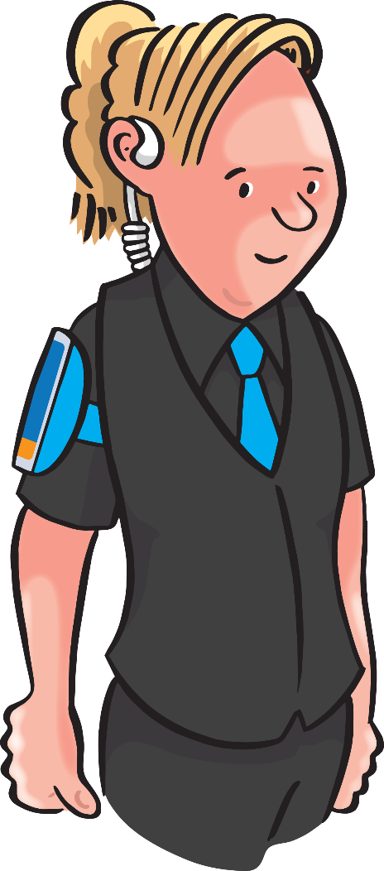
Door supervisors
Door supervisors:
those who carry out security duties in or at licensed premises, like pubs and nightclubs, preventing crime and disorder and keeping staff and customers safe.
Notes:
Door supervisors - those who carry out security duties where alcohol is being consumed.
This SIA licence also includes the duties of a security and retail officer. Many people with this licence do not work stereotypical venues such as night clubs but may require this licence to work an event with a bar.

Slide 17
Security officers: guarding
Security officers (guarding):
those who guard premises against unauthorised access or occupation, outbreaks of disorder, theft or damage.
Notes:
Security officers (guarding) – this sector includes providing security at factories, retail premises, building sites and hospitals - in effect, anywhere that alcohol is not being consumed. It also allows the individual to work at an off-licence (e.g. supermarket) as alcohol is only being sold, not served.
Security officers (guarding) may also guard individuals against assault/injury as the result of the unlawful conduct of others.
They can either provide physical protection or protection by way of patrolling or surveilling, thereby deterring crime.

Slide 18
Security officers: key holding
Key holding
Key holding is where a security officer keeps custody of, or controls access to, any key or similar device for operating (whether mechanically, electronically or otherwise) any lock.
Notes:
Key holding is not a specific license but is an SIA-regulated sector. Someone who locks/unlocks or responds to an alarm activation is required to hold either a door supervisor or security officer SIA licence. This does not apply to an individual such as a caretaker in a school who is employed directly by the company who owns/rents the premises.
Key holders do not provide security themselves, they simply hold the keys for the company.

Slide 19
Cash and valuables in transit (CVIT)
Cash and valuables in transit operatives:
those who guard property against destruction or theft while using secure transportation of the property in specially manufactured vehicles.
Notes:
Cash and valuables in transit operatives will operate secure machinery, for example money vans.

Slide 20
CCTV
CCTV operators:
those who carry out guarding activities using closed-circuit television equipment to either monitor the activities of members of the public in a public or private place, or to identify a particular person.
Notes:
A CCTV operator’s role includes watching live images and reviewing footage not including themselves. It also includes reviewing images from body-worn cameras.
This does not apply to individuals employed directly by the business but is an additional licence for all contracted security operatives. Anyone can review footage that includes themselves for the purpose of accurately writing an incident report.

Slide 21
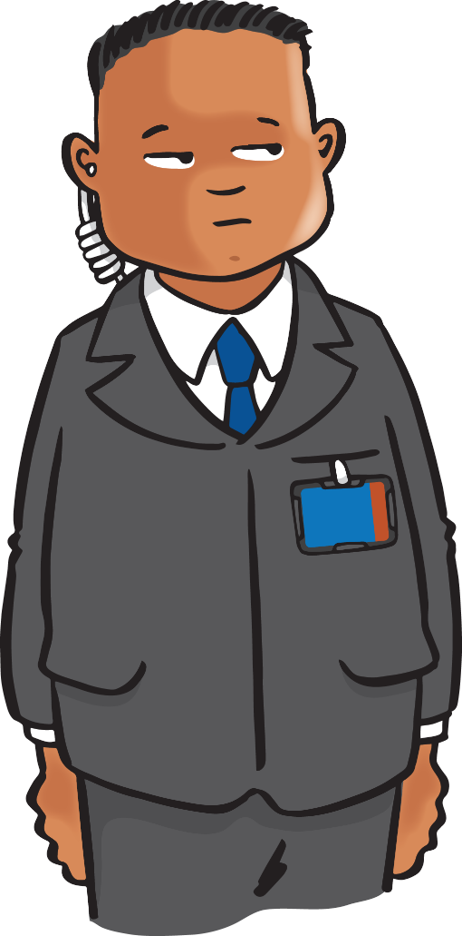
Close protection
Close protection operatives:
those who guard one or more individuals against assaults or injuries that might be suffered as a consequence of the unlawful conduct of others.
Notes:
Close protection operatives are commonly called bodyguards.
Their roles may include protecting people or property.
This is currently (January 2020) the only SIA licence that would also allow the holder to work in the door and security officer sectors.

Slide 22
Vehicle immobilisers
Vehicle immobilisers:
security operatives who either remove or relocate vehicles, restrict the movement of vehicles using a device or release vehicles after demanding or collecting a charge
BUT - only licensed by the SIA in Northern Ireland.
Notes:
Vehicle immobilisers are only licensed by the SIA in Northern Ireland. These are security operatives who either remove or relocate vehicles, restrict the movement of vehicles using a device or release vehicles after demanding or collecting a charge.

Slide 23
Individual licensing
Licensing ensures that security operatives are:
‘fit and proper’ persons
properly trained and qualified to do their jobs
The SIA sets standards of conduct, training and supervision within the industry.
Notes:
Licensing ensures that security operatives are ‘fit and proper’ persons who are properly trained and qualified to do their jobs.
Fit and proper is not just a physical limitation but also refers to the operator’s mental state e.g. is it a good idea to work a shift directly after someone close to you has died?
Anyone wishing to work as a security operative must have an SIA licence before they start work.

Slide 24
Getting a licence
Apply to the SIA itself
Your identity will be verified
Specified training must be undertaken
Your criminal record will be checked
A license fee will be payable
Licence will last for 3 years before renewal.
Notes:
An individual will need to set up an account on the SIA website (https://www.sia.homeoffice.gov.uk/Pages/licensing-applying.aspx). Once set up, an employer can link to it and complete the application on the individual’s behalf, or the individual can complete it. Once submitted, it will message the applicant telling them their reference number and which documents to take to the approved post office. They must present their application reference number and the documents. The post office will take the payment and their photograph.

Slide 25
Working without a licence
Criminal offence
Fines of up to £5,000
Up to a 6-month prison sentence
Criminal offence for an employer to use an unlicensed security operative.
Notes:
Anyone wishing to work as a security operative must have an SIA licence before they start work, unless working for an ACS-approved company.
It is the legal responsibility of the security company, and the business they send you to work for, to check that your SIA licence is valid. This can be done on the SIA website.

Slide 26
Standards of behaviour
Security operatives must always conduct themselves professionally as clients/members of the public expect them to display certain standards of behaviour
What qualities do you think security operatives should possess?
Notes:
Class question: What qualities do you think security operatives should posses?
Answers are on the next slide. You may consider taking answers in an open format or on a flip chart.

Slide 27
Standards of behaviour cont.
Security staff should be…
Professional
Polite
Alert
Approachable
Self-disciplined
Good communicators
Effective problem solvers
Honest
Fair
Observant
Smart
Cooperative
Positive
Team players
Loyal
Reliable
Responsible
Helpful
Tactful
Sensitive
Patient.
Notes:
Answers
Discuss why these qualities apply to a security operative, for example ‘smart’ relates to a security operative’s appearance and being ‘loyal’ could suggest that they would arrive for their shift even if a different venue offered them a slightly higher pay rate an hour before their shift was due to start.
Could also mention the following traits:
sensitive
responsible
courteous
handle sensitive situations
If learners mention traits other than those above, discuss why/if they apply to security operatives.
Above all security operatives should have integrity and be prepared to take responsibility for their action.

Slide 28
SIA Code of Behaviour
Security operatives MUST always conduct themselves:
in strict accordance with the SIA’s Code of Behaviour for their particular role within the industry
according to their own organisation’s values and standards.
Notes:
The SIA Code of Behaviour is available on the SIA website but the contents of it are explained during this course.

Slide 29
Community safety initiatives
Improving the physical security of vulnerable areas
Improve the environment
Removing the means and opportunities to commit crime
Provide funding for extra lighting and CCTV Communal radio systems
Pubwatch/Shopwatch initiatives
Warning signs
Using CCTV
Using the yellow and red warning cards.
Notes:
Encourage learners to research what is available in their areas.
Local authorities now use Safer Community Partnerships to help reduce crime and the fear of crime in their areas. They work together with the police, the other emergency services and other relevant public and private organisations
to try to reduce crime, public disorder, reoffending, anti-social behaviour, substance misuse and vandalism.
Crime reduction initiatives try to do this by:
• improving the physical security of vulnerable areas
• improving the environment itself
• removing the means and opportunities to commit crime
• using extra lighting to improve visibility in an area
• using warning signs
• controlling access to certain areas at specific times
• using CCTV
• using radio communications between various organisations and companies
• making use of local and national Pubwatch and Shopwatch initiatives
• using the yellow and red warning cards in conjunction with the local Pubwatch policy

Slide 30
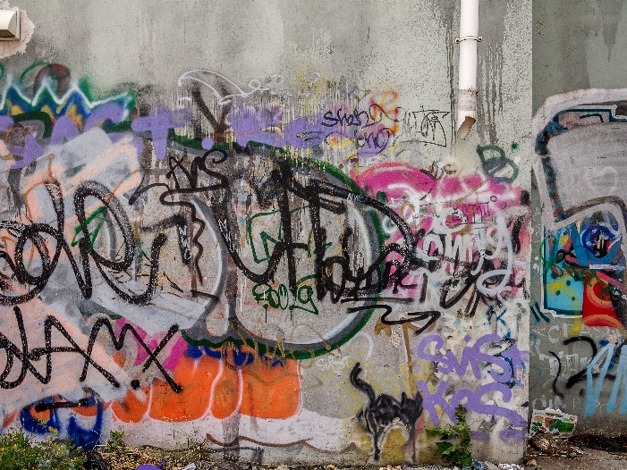
Aims of crime reduction initiatives
To try to reduce:
crime
public disorder
reoffending
antisocial behaviour
substance misuse
vandalism/graffiti.
Notes:
The main aims of local crime reduction partnerships are to reduce crime, public disorder, reoffending, antisocial behaviour, substance misuse and vandalism.

Slide 31
Assignment instructions - A.I.s
Assignment instructions (A.I.s)
These are a set of written guidelines on what needs to be done and how it should be done on that particular site
Complying with these instructions will ensure you stay within the law and the client’s requirements.
Notes:
Assignment instructions - A.I.s
Describe in detail the security operative’s activities for each site, emergency procedures and contact numbers.
This term is not usually used in licensed premises but is primarily used in static premises, including building sites, factories, retail etc.

Slide 32
A.I.s
CLIENT
SECURITY COMPANY
CONFIDENTIAL OPERATIONAL PROCEDURES
DUTIES.
SECURITY OPERATIVE
Notes:
Flow diagram of how A.I.s are created and used.

Slide 33
A.I.s cont.
A.I.s contain details and instructions on:
duty times
site plans
site risks
location of high-value property
areas of vulnerability
patrol times/routes
access/egress procedures
search procedures
reporting procedures
health and safety issues
first-aid procedures
methods for calling the emergency services
important contact telephone numbers
emergency and evacuation procedures
alarm/surveillance systems
methods of communication
relevant documents.
Notes:
A.I.s will contain details and instructions on each item included on the slide.

Slide 34
A.I.s cont.
Always read the A.I.s when you start on a new site
Keep yourself up to date with the contents
You may need to sign a form confirming that you have read the A.I.s at the start of each shift
A.I.s are CONFIDENTIAL documents – keep them secure.
Notes:
A.I.s are CONFIDENTIAL documents and must be kept securely so that unauthorised people do not have access to them.

Slide 35
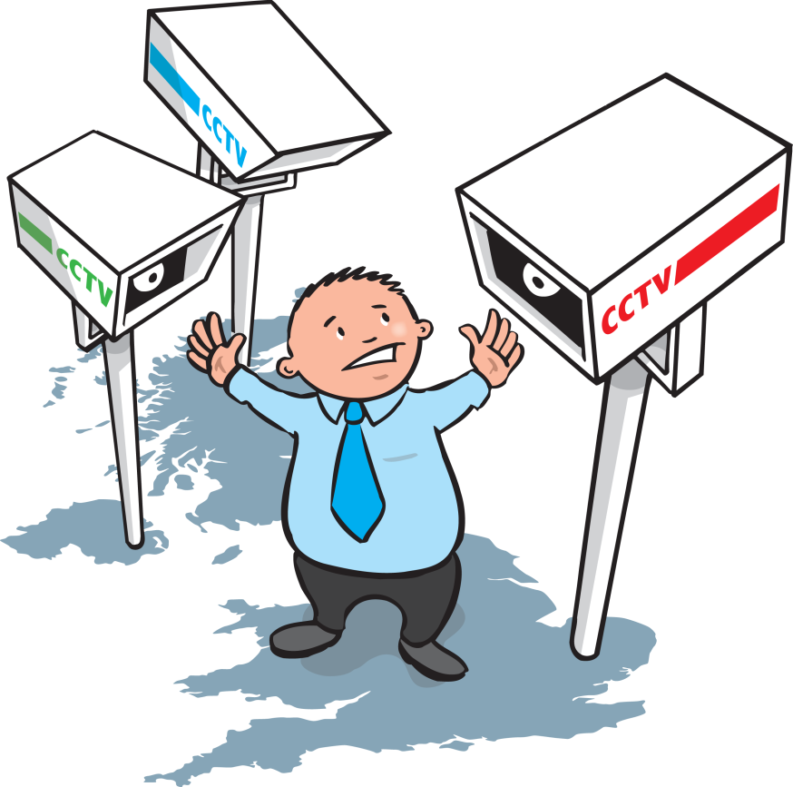
Benefits of using CCTV
Prevents crime
Reduces incidents
Reduces costs/risks by not
having to employ additional
patrolling staff
Can provide clear evidence for investigations
Can be used as evidence in court.
Notes:
CCTV does not prevent crime but the learning outcome and therefore exam questions may state this.
There are many benefits that come with using CCTV, for example:
CCTV does deter some people from committing a criminal act.
it can reassure customers/staff of their safety
monitoring CCTV is safer than actually patrolling a site and monitoring multiple screens at once can allow you to observe a site quicker than if you were to walk around it. As there is less risk to the security operative, there is therefore less time off sick after incidents/accidents and no compensation claims if injury occurs during a physical patrol.
There are also disadvantages of using CCTV, for example:
the evidence obtained from CCTV is only good if the system meets requirements and has sufficient coverage
blind spots could adversely affect the chain of evidence if footage does not adequately prove or disprove guilt
poor quality images may not be admissible in court

Slide 36
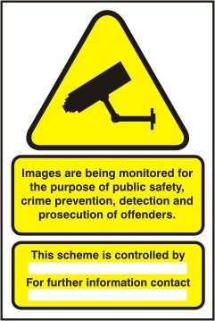
What are the legal implications of using CCTV?
CCTV systems must be registered with the Information Commissioner's Office (ICO)
One person must be registered as responsible and accountable for the system
Signage must be clearly displayed at each entrance point to premises or site to state
CCTV is in operation
Must not record anywhere where people are expected to undress, e.g. toilet cubicles or front footage of urinals.
Notes:
Class question: What are the legal implications of using CCTV?
CCTV systems should ideally be monitored at all times and must be registered for an approved use, e.g. health and safety and security
The accountable person is the data controller
Signage must state the approved purpose, who is operating the system (data controller’s name or company name), contact number for queries about the system and subject access requests (copies of footage involving the person requesting the copy)

Slide 37
Data protection legislation when using CCTV
The ICO approval includes the declared time that footage can be retained on the system before it over-records
Approved list of who can access the CCTV system known as ‘authorised persons’
Recordings must be used appropriately.
Notes:
The maximum time that footage can be retained on the system is usually 28 days; this does vary but must be justified.
The general review of live footage must be done by trained and authorised people only, e.g. human resources cannot view CCTV to verify staff performance without the permission of the employees.
Must only record for the purposes that are stated in the ICO approval.

Slide 38
Limitations of CCTV
Privacy issues and concerns
Vulnerable to damage and vandalism
Misuse
Cannot prevent crime
Cost
Familiarity with scope of cover
Technology vulnerabilities.
Notes:
There may be some limitations of using CCTV, for example:
some people do not like being recorded as they feel it violates their privacy
incorrectly positioned cameras may be damaged (they should be positioned well above head height to avoid this)
operative misuse
some people will wear items to cover their face
initial cost can be prohibitive
an operator’s ability and knowledge of how to use the equipment - do they know where the blind spots are?
wireless signals can be disrupted, and cables can deteriorate over time
it may be misused for the unauthorised monitoring of people (illegal in many cases)

Slide 39
Key Task 1
1
What does the abbreviation SIA stand for?
...................................................................................................................
...................................................................................................................
...................................................................................................................
Notes:
Ask delegates to complete the key tasks for this section in their handouts, or to complete it in groups in the classroom.

Slide 40
Key Task 1
1
What does the abbreviation SIA stand for?
Security, Industry, Authority.
...................................................................................................................
...................................................................................................................
...................................................................................................................

Slide 41
Key Task 1
2
Describe the THREE main aims of the SIA.
…...................................................................................................…...................................................................................................…...................................................................................................…...................................................................................................…...................................................................................................…...................................................................................................
1
2
3
Notes:
Ask delegates to complete the key tasks for this section in their handouts, or to complete it in groups in the classroom.

Slide 42
Key Task 1
2
Describe the THREE main aims of the SIA.
Protect the public and regulate the security industry through licensing
…...................................................................................................…...................................................................................................…...................................................................................................…...................................................................................................…...................................................................................................…...................................................................................................
1
2
Monitor the activities and effectiveness of those working in the industry
3
Set and approve standards of conduct, training and supervision within the industry.

Slide 43
Key Task 1
3
Identify FIVE standards of behaviour expected of a security operative.
…....................................................................................................…....................................................................................................…....................................................................................................…...................................................................................................…................................................................................................
1
2
3
4
5
Notes:
Ask delegates to complete the key tasks for this section in their handouts, or to complete it in groups in the classroom.

Slide 44
Key Task 1
3
Identify FIVE standards of behaviour expected of a security operative.
…....................................................................................................…....................................................................................................…....................................................................................................…...................................................................................................…................................................................................................
1
Professional
Polite
Honest
Observant
Approachable.
2
3
4
5

Slide 45
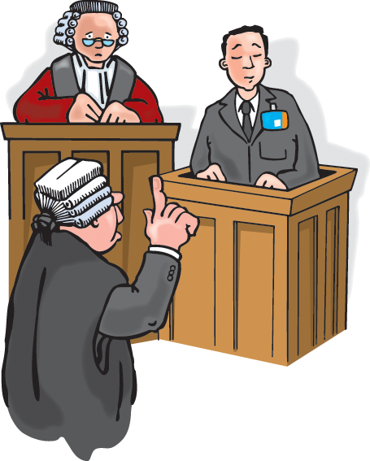
1:2
Legislation
Notes:
Completion of this module will enable learners to meet the following learning outcome:
Learning outcome 2: Understand legislation as it applies to a security operative
This includes assessment criteria:
2.1 Identify the differences between Civil and Criminal Law
2.2 State the main aims of the Private Security Industry Act 2001
2.3 Identify key legislation relating to promoting equality and diversity in the workplace
2.4 Identify licensable roles under the Private Security Act
2.5 Identify how data protection regulation impacts on the security operative
This module includes the following interactive activities:
Key task 2

Slide 46
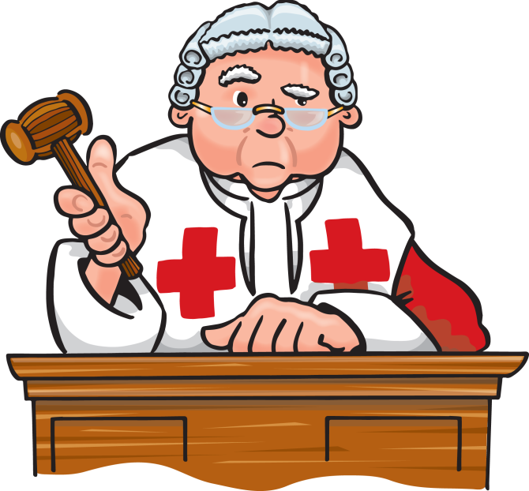
Civil law
Civil laws usually deal with disputes between people, companies or other organisations
They deal with things like:
libel
slander (known as defamation in Scotland)
personal injury cases
trespass.
Notes:
Civil laws help govern our daily lives.
Civil offences:
themselves do not occur a potential prison sentence
Civil cases are usually dealt with in the county courts, with more serious cases being heard in the High Court. In Scotland, civil cases are heard by the
Sheriff Court with more serious cases being heard at the Court of Session.

Slide 47
Civil law cont.
Other cases dealt with under civil law include:
family and matrimonial disputes
personal injury cases
employment law
breach of contract
The standard of proof is ‘on the balance of probabilities’.
Notes:
Civil laws help govern our daily lives.
Other cases dealt with under civil law include:
family and matrimonial disputes
personal injury cases
employment law
breach of contract
Ensure that you emphasise that the standard of proof in the civil court is ‘on the balance of probabilities’.

Slide 48
Trespass
Trespass:
A trespass is committed by a person who is improperly on someone else’s property without consent.

Slide 49
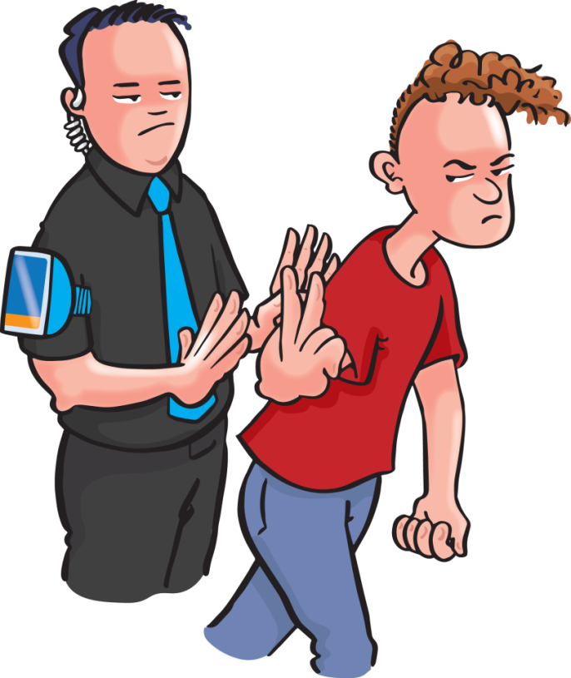
Trespass cont.
Trespass:
is not normally a criminal offence
can be actionable through the civil courts
is an act of interference against the ‘lawful occupier’.
Notes:
The act of trespass is being somewhere without permission and is itself classed as a civil offence, however it may be coupled with an indictable (criminal) offence such as threats to harm or criminal damage.
The ‘lawful occupier’ is someone who owns, occupies or has control over the property, for example the owner, manager or person in charge of the premises or any member of staff acting on their behalf, including a security operative.
Examples of trespass include:
refusing access to a shop as it is due to close, but the person still walks into the shop
gaining entry to a site through a hole in the fencing even if the trespasser did not create the hole
asking someone to leave licensed premises and the individual not complying with the request
Scotland
The Trespass (Scotland) Act 1865 makes it an offence under Scots law to trespass.
Trespass in licensed premises in Scotland
Under Section 116 of the Licensing (Scotland) Act 2005 it is an offence for any person to refuse to leave licensed premises as follows:
a person on any relevant premises who behaves in a disorderly manner,
and refuses or fails to leave the premises on being asked to do so by a responsible person or a constable, commits an offence
a person on any relevant premises who, after the end of any period of licensed hours, refuses or fails to leave the premises on being asked to do so by a responsible person or a constable commits an offence
Northern Ireland
In relation to trespass, the new criminal trespass law enacted under s128 of SOCPA, has made it illegal to trespass on certain designated military and nuclear sites in Northern Ireland. There is a common law offence of trespass against property and a criminal law offence of trespass/harassment against the person, including assault.

Slide 50
Trespass cont.
Security operatives may ask people to leave a premise if they:
have no reason to be there
break criminal laws
break licensing laws
breach specific premise rules or conditions
start to display unacceptable behaviour.

Slide 51
REACT
REACT explains the best way to remove a trespasser
Request them to leave
Explain the reasons for the request
Appeal for them to leave, explaining what will happen if they do not
Confirm that they are still refusing to leave peacefully
Take action (eject).
Notes:
REACT is a model for when someone has accessed your premises and you are requesting them to leave.
A good exercise for the group could be to slightly amend the model to one for refusing entry, for example:
R - request the person not to enter
E - explain the reasons for the request
A- appeal for them to not attempt to enter explaining what will happen if they do attempt to enter
C - confirm they still intend to enter
T - take action (close the door, block their entry path etc.)

Slide 52
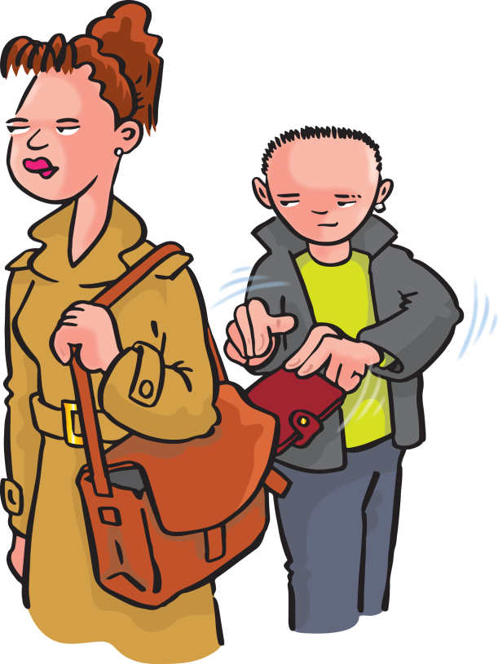
Criminal law
Criminal laws are in place to prevent people from committing more serious offences and to punish people when those laws are breached
Offences are usually committed against people
or property
Cases are normally brought by the state
Guilty verdicts can result in fines, probation orders and terms of imprisonment
The standard of proof in the criminal courts is ‘beyond reasonable doubt’.
Notes:
Criminal laws come from either:
very old judicial decisions made in courts (common law)
Acts of Parliament (statute law)
Cases are normally brought by the state, often following an arrest.
Prosecution is sought through the criminal courts.
Emphasise that a criminal offence may result in imprisonment and possibly a fine.
The standard of proof in the criminal courts is ‘beyond reasonable doubt’ due to potential to take away a person’s liberty.
This slide has the potential for a discussion about whether juries are really objective in modern times as most cases are described on social media or the news. Can a modern day jury really not have any preconceived ideas about what happened?

Slide 53
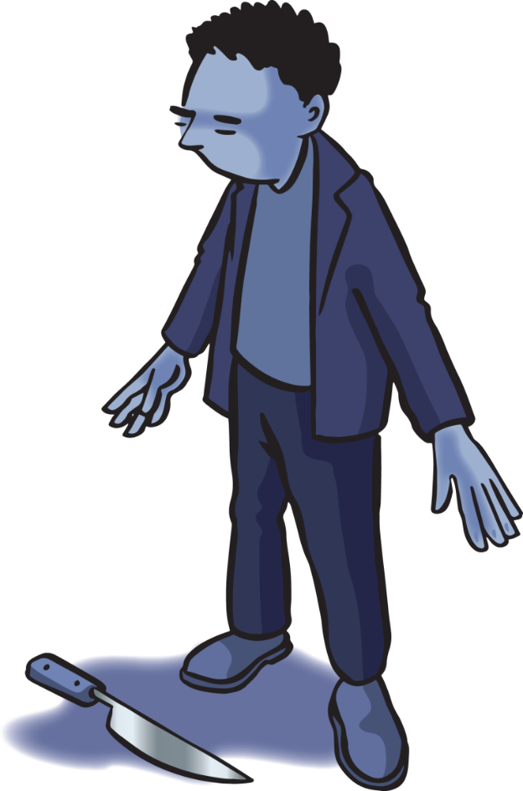
Serious crimes include:
murder
rape
assault (ABH, GBH,GBH w/i)
sexual assault
possession/ supplying of drugs
possession of an offensive weapon
firearms offences
theft, fraud, robbery and burglary
criminal damage (and with intent to endanger life)
driving under the influence
arson
child abuse
domestic abuse
kidnapping or holding someone against their will.
Notes:
Serious crimes include:
murder - intentionally killed another person
rape – insertion of penis without permission into anus, mouth or vagina
ABH – actual bodily harm – cuts, bruises and broken nose
GBH – grievous bodily harm – broken bones etc.
GBH w/i – grievous bodily harm with intent – planned breaking of bones etc.
sexual assault – physical/psychological/emotional violation in the form of a sexual act, imposed on someone without their consent
drugs is referring to illegal drugs e.g. cocaine, heroin etc.
theft – stealing an item
fraud – misappropriating money or an item by the means of deception e.g. pretending to be a builder, taking the deposit and then never going to complete the work paid for
robbery – the act of theft but with a person involved e.g. robbing a bag
burglary (housebreaking in Scotland) - entering premise with the intention to steal
arson (wilful fire-raising in Scotland) – deliberately setting fire to something with the intention to cause damage
threats to harm and or damage, child and domestic abuse are as per their titles
kidnapping – consider arresting the wrong person as well as general kidnapping

Slide 54
The Private Security Industry Act
The Act was brought in to:
regulate the UK’s private security industry
help raise standards of individuals and companies
increase the public’s confidence in the sector
increase public safety
The SIA is the government’s corporate body who regulate the private security industry.
Notes:
The Private Security Industry Act
As well as the above, the Private Security Industry Act also intended to remove criminal elements from the private security industry and established licensing of individuals.
http://www.legislation.gov.uk/ukpga/2001/12/contents

Slide 55
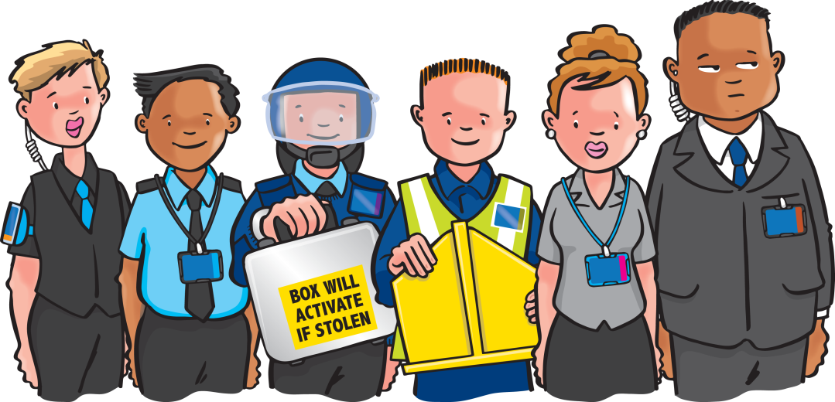
The Private Security Industry Act cont.
The act allows the SIA to:
license individuals in specific sectors
approve security companies
monitor the activities and effectiveness of those in the industry
remove criminal elements from the industry
keep the industry under review
conduct inspections
set standards of training and supervision
make recommendations to improve standards.

Slide 56
The Equality Act
A prejudice is a hostile attitude towards someone who belongs to a certain group, simply because they belong to that group, and are therefore assumed to have all of the characteristics ascribed to that group
Stereotyping is when we lump certain groups of people together, assuming that they are all the same simply because they belong to that group.
Notes:
Equality and diversity in the workplace
The SIA is only concerned with our negative prejudices.

Slide 57
The Equality Act cont.
The Equality Act prohibits discrimination based on:
age
disability
gender reassignment
marriage and civil partnership
pregnancy and maternity
race
religion
sex
sexual orientation
Known as ‘protected characteristics’.
Notes:
The Equality Act
These are known as protected characteristics.
Larger companies must now monitor the ratio of genders and ensure all are being treated equally, regardless of gender or protected characteristics.
protected characteristics.
Northern Ireland
In Northern Ireland, discrimination is illegal under the following laws:
• The Race Relations (Northern Ireland) Order 1997
• The Sex Discrimination (Northern Ireland) Order 1976
• The Disability Discrimination (Northern Ireland) Order 2006
As a security operative, you cannot refuse entry or evict anyone on the grounds of sex, race, colour, disability or physical appearance. Should you refuse entry to or evict an individual for any of these reasons alone then you will be committing an offence. The individual who has been discriminated against has the right to make a formal complaint to the premises management requesting an apology, a commitment that such discrimination does not reoccur or even compensation. If the issue is not dealt with to their satisfaction, they may even take legal action against you and your employer.

Slide 58
The Equality Act cont.
The Equality Act also applies to:
recruitment
access to training
pay and benefits
promotion opportunities
terms and conditions
redundancy
dismissal
making reasonable adjustments
for employees with specific needs/disabilities.
Notes:
The Equality Act
It is illegal for employers to discriminate against any of these groups of people in the areas of recruitment, access to training, pay and benefits, promotion opportunities, terms and conditions, redundancy and dismissal.
Furthermore, employers now have to make reasonable adjustments to cater for the employment of disabled people.

Slide 59
Types of discrimination
Direct discrimination occurs when someone is treated less favourably than another person because of a protected characteristic they have or are thought to have, or because they associate with someone who has a protected characteristic
Indirect discrimination occurs when a policy or practice that applies to everyone particularly disadvantages people who share a protected characteristic.
Notes:
Types of discrimination
Direct discrimination occurs when someone is treated less favourably than another person because of a protected characteristic they have or are thought to have, or because they associate with someone who has a protected characteristic.
Indirect discrimination occurs when a policy or practice that applies to everyone particularly disadvantages people
Discrimination can be hurtful, insulting and demeaning to the recipient, and is not acceptable from security professionals.

Slide 60
The Human Rights Act
It is also made clear under the Human Rights Act that all people have the right to be free from discrimination.
Notes:
The Human Rights Act is a worldwide charter.
Most of what it covers is also included in the Equality Act, Health & Safety at Work etc Act 1974 and other UK legislation.
Main articles of interest are on the next slide.

Slide 61
The Human Rights Act cont.
Human Rights Act articles:
Article 2
right to life
Article 3
prohibition of torture
Article 5
right to liberty and security
Article 6
right to a fair trial
Article 7
no punishment without law
Article 14
prohibition on discrimination.
Notes:
There are more articles within this Charter.

Slide 62
Data Protection Act
Data Protection Act
Control of data (images)
Collection of images in public, code of practice
6 principles of data protection.
Notes:
The Data Protection Act 2018 enabled the General Data Protection Regulation (GDPR).
It can be anything from:
a name
a photo
an email address
bank details
social media posts
biometric data
medical information.
It will also introduce ‘digital rights’ for individuals.

Slide 63
Data Protection Principles
(a) Processed lawfully, fairly and in a transparent manner
(b) Collected for specified, explicit and legitimate purposes and not further processed in a manner that is incompatible with those purposes
(c) Adequate, relevant and limited to what is necessary in relation to the purposes for which they are processed.
Notes:
1 – as per operational requirement (ICO approval), e.g. health and safety and security for CCTV
2 – e.g. not for staff performance unless employees have agreed this use and is part of the operational requirement.
3 - e.g. information for employment records

Slide 64
Data Protection Principles cont.
(d) Accurate and, where necessary, kept up to date
(e) Kept in a form which permits identification of data subjects for no longer than is necessary for the purposes for which the personal data are processed
(f) Processed in a manner that ensures appropriate
security of the personal data.
Notes:
4 - e.g. up-to-date addresses and phone numbers of all employees
5 – employment records, e.g. bank details, should not be kept once an employee that has left the business has been fully paid
6 – passwords etc.
Data protection rules often apply to the use of written records and notebooks, as well as the use of body-worn cameras.
You can find more information about the General Data Protection Regulation 2018 here:
https://ico.org.uk/for-organisations/guide-to-the-general-data-protectionregulation-gdpr/?q=digital

Slide 65
Body-worn cameras (BWC)
The wearer does not require a CCTV operator licence
Must be clearly visible to the person(s) it is recording
Images must be downloaded by an authorised person
Images must be stored securely on an approved system
Camera does not replace the need to complete your notebook or company documentation, e.g. incident reports.
Notes:
The owner (business) of the BWC must have approval with the ICO to use this equipment
Individuals named on the CCTV-authorised list can download and review
Storage system and length of storage is stated on the ICO approval

Slide 66
Key Task 2
1
Describe civil law and criminal law.
Civil law
Criminal law
Notes:
Ask delegates to complete the key tasks for this section in their handouts, or to complete it in groups in the classroom.

Slide 67
Key Task 2
1
Describe civil law and criminal law.
Civil law
Criminal law
Civil law helps govern our daily lives
Criminal law prevents people from committing more serious offences, usually against people or property.

Slide 68
Key Task 2
Identify the key legislation relating to equality and diversity in the workplace.
2
...................................................................................................................
...................................................................................................................
...................................................................................................................
Notes:
Ask delegates to complete the key tasks for this section in their handouts, or to complete it in groups in the classroom.

Slide 69
Key Task 2
Identify the key legislation relating to equality and diversity in the workplace.
2
The Equality Act 2010.
...................................................................................................................
...................................................................................................................
...................................................................................................................

Slide 70
Key Task 2
Explain how the data protection regulation impacts your role as a security operative.
3
...................................................................................................................
...................................................................................................................
...................................................................................................................
Notes:
Ask delegates to complete the key tasks for this section in their handouts, or to complete it in groups in the classroom.

Slide 71
Key Task 2
Explain how the data protection regulation impacts your role as a security operative.
3
The legislation covers any information related to a person or ‘data subject’ that can be used directly or indirectly to identify them e.g. incident reports, notebooks, identification, CCTV.
...................................................................................................................
...................................................................................................................
...................................................................................................................

Slide 72
1:3
Arrest Procedures
Notes:
Completion of this module will enable learners to meet the following learning outcome:
Learning outcome 3: Understand arrest procedures relevant to security operatives
This includes assessment criteria:
3.1 State the meaning of arrest
3.2 Identify offences for which a security operative can make an arrest
3.3 Identify the limitations to a security operative’s powers of arrest
3.4 State procedures to follow when making an arrest
3.5 State why an arrest should only be made as a last resort
3.6 State procedures following an arrest
3.7 State what is meant by ‘reasonable’ and ‘necessary’ force
This module includes the following interactive activities:
Key task 3

Slide 73
Arrest
An arrest or apprehension is
the taking or restraint of a person from his liberty in order that he shall be forthcoming to answer an alleged crime or offence.
Notes:
It is a good idea to advise learners to learn their local arrest policies and work with their local police in relation to arrest.

Slide 74
Arrest is a last resort
Taking away someone’s liberty is a very serious matter. Prior to acting, you must consider:
whether you have powers of arrest (is it an indictable offence?)
how long until/can the police attend?
how you are going to stop the person from leaving and where are you going to this?
whether you have a colleague to act as your witness
if you are covered by CCTV
if the person is likely to attempt to assault you
Remember, your safety is as important as a customer’s safety.
Notes:
Discuss what the police response time is for the area that you are teaching in.

Slide 75
Indictable offences
Certain serious offences have been given a special condition within the criminal law and are known as ‘indictable offences’
The majority of serious crimes that security operatives come across will fall within this category
Indictable offences are those that may be tried at a Crown Court.
Notes:
In Scotland the term is arrestable, not indictable, offences.
Indictable offences are defined under Section 24a of the Police and Criminal Evidence Act 1984 (PACE) Article 26 PACE (Northern Ireland).

Slide 76
Arrest for indictable offences
Section 24a of the Police and Criminal Evidence Act 1984 says that:
A person other than a constable (which includes security operatives) may arrest without a warrant:
Anyone who is in the act of committing an indictable offence
Anyone whom he has reasonable grounds for suspecting to be committing an indictable offence
Where an indictable offence has been committed, a person other than a constable may arrest without a warrant:
Anyone who is guilty of the offence
Anyone whom he has reasonable grounds for suspecting to be guilty of it.
Notes:
Section 24a of the Police and Criminal Evidence Act 1984 (as amended by the Serious Organised Crime and Police Act of 2005). This Act was brought in to address the difficulties of the numerous and varied powers of arrest from the past, and now provides a power of arrest for most criminal offences where such a power is necessary (Article 26 PACE (Northern Ireland).
Constable means a warrant police officer.
A person other than a constable means non warranted individuals including security operatives hence the term Citizen’s Arrest.

Slide 77
Arrest for indictable offences cont.
But this power of arrest is only exercisable if:
The person making the arrest has reasonable grounds for believing that for any of the reasons mentioned it is necessary to arrest the person in question
It appears to the person making the arrest that it is not reasonably practicable for a constable to make it instead
Security operatives have no more powers of arrest than any other citizen.
Notes:
But this power of arrest is exercisable only if:
the person making the arrest has reasonable grounds for believing that for any of the reasons mentioned it is necessary to arrest the person in question; and
it appears to the person making the arrest that it is not reasonably practicable for a constable to make it instead.

Slide 78
Reasons to arrest
The reasons to arrest are to prevent the person from:
causing physical injury to themselves or any other person
suffering physical injury
causing loss of or damage to property
making off before a constable can assume responsibility for them.
Notes:
The limitations to powers of arrest
Under Section 24a of the Police and Criminal Evidence Act (PACE) 1984, (the Criminal Procedure (Scotland) Act 1995, S26a of the Police and Criminal Evidence (Northern Ireland) Order 1989 (SI 1989/1341), certain serious offences have been given a special condition within criminal law and are known as indictable offences. The majority of crimes that security operatives come across will fall within this category. Indictable offences are those that may be tried at a Crown Court.

Slide 79
Power of arrest
Offences under this section, for which all security operatives have the same powers of arrest as other members of the public include:
murder/homicide
culpable homicide
assault (ABH, GBH and GBH w/i)
rape
sexual assault
firearms offences
drugs offences
robbery
theft
burglary/housebreaking
fraud
criminal damage and malicious mischief (Scotland).
Notes:
Offences under this section, for which all door supervisors have the same powers of arrest as other members of the public include:
murder (also known as culpable homicide in Scotland)
aggravated assault (also known as serious assault in Scotland) - legally known as GBH with intent
burglary (also known as housebreaking in Scotland)
criminal damage (also known as malicious mischief in Scotland)

Slide 80
Breach of the peace
A breach of the peace is a common law concept that has very ancient roots
In general terms it is considered to be:
‘any disorder or disruption to the peace in public or in private that results in violence, threat of violence or provokes violence from another’.
Notes:
Breach of the Peace
A breach of the peace is a common law concept that has very ancient roots.
In general terms it is considered to be ‘any disorder or disruption to the peace in public or in private that results in violence, threat of violence or provokes violence from another’.
This common law is not an indictable offence. Therefore the person cannot be charged with a breach of the peace. They may be charged under a different piece of legislation, e.g. Offence Against the Person 1861.
Citizen’s arrest only refers to indictable offences, therefore a security operative would not be able to arrest for a breach of the peace.
Scotland
Breach of the peace in Scots law
Breach of the peace is a common law offence against society and is defined as ‘conduct severe enough to cause alarm to ordinary people and threaten serious disturbance to the community’. The words ‘severe’ and ‘serious’ above are an essential element of breach of the peace and therefore it is not considered a trivial crime. Some breaches of the peace might be more ‘minor’, such as cursing or swearing in public, peering in a person’s window or shop window and causing alarm to other people, or more serious incidents such as fighting in public or conducting oneself in a riotous or disorderly manner.
The common law crime of breach of the peace is that it can be committed by 1 or more people, so long as the conduct of the person or people is riotous or disorderly, while the conduct must be severe enough to cause alarm to ordinary people and threaten serious disturbance to the community (Common law).

Slide 81
When to arrest
Security operatives should only arrest someone for one of the following reasons:
To prevent an offence being committed
To prevent the continuance of an offence
To prevent the renewal of an offence
To detain someone for an offence already committed.
Notes:
The individual must be committing an indictable offence (arrestable in Scotland).

Slide 82
How to arrest
The person must be told:
Who you are (if not obvious);
‘I am a member of the security team here’
That they are under arrest;
‘You are under arrest……...’
What they are being arrested for;
‘…….for criminal damage’
The grounds for the arrest;
‘I have just seen you breaking that window’
That the police will be called.
‘We are calling the police and you must wait here until they arrive’.
Notes:
Where possible, arrests should be made as quietly and as discreetly as possible to avoid situations from escalating and becoming out of control.
Security operatives should take care not to show an over-aggressive attitude when effecting an arrest, just a firmness of intent.
Once the decision has been made to arrest someone, the person must be told that they are under arrest as per the slide.

Slide 83
During an arrest
When carrying out an arrest:
use everyday words
do not ‘caution’ the suspect
explain the reasons for the arrest
only use force, if necessary, to prevent escape or assault
treat the person reasonably
you are in charge of their welfare until the police arrive.
Notes:
Always consider how long the police may take to arrive at the scene. Do you really need to arrest the person or do you have sufficient evidence, e.g. good CCTV evidence, for the police to be able to arrest them at a later time?
Once you have arrested someone, you are responsible for their safety. You will need an area to keep them and CCTV, or at least 2 members of staff, to monitor them.

Slide 84
The arrest
After an arrest, you are responsible for the person
ensure own safety
ensure the person’s safety
ensure the evidence is preserved
hand over the person and the evidence to the police; explain reason for arrest in front of person and police
record the arrest
assist police with a statement
possibly attend court to give evidence
discuss the arrest procedure with the police.
You must:
Notes:
After the arrest
Having arrested someone, you are then responsible for the suspect's welfare and safe custody until the arrival of the police.
You need to explain the reason for the arrest and how it was done to the police in front of the person as this is their opportunity to claim it was an unlawful arrest. If the person pleads guilty at court you will not need to attend the hearing.
While you have access to a police officer, you may wish to ask for some feedback on your arrest technique.

Slide 85
Unlawful arrest
You can use your powers of arrest in the course of crime prevention and detection
Relatively few successful civil/criminal actions have been taken against security staff for unlawful arrest
Use discretion and common sense when deciding when to effect an arrest
Ensure you have the power to arrest in the first place.
Notes:
Unlawful/false arrest
Provided that discretion and common sense are used in deciding when to effect an arrest, and that when you are making the arrest you have reasonable grounds to suspect that the person is either committing or has committed an indictable offence, then you should not encounter too many problems.

Slide 86
Your safety
Never put yourself in any unnecessary danger while effecting an arrest
If you are in any doubt about your ability to make the arrest, or about your personal safety, then the police should be called to:
assist with the arrest
make the arrest themselves.

Slide 87
Self-defence
Common law – the rules of self-defence:
if any person has an honestly held belief that he or another is in imminent danger, then he may use such force as is reasonable and necessary to avert that danger.
Notes:
Scotland: ‘In Scots law, if a person is attacked, or is in reasonable fear of attack, he’s entitled deliberately to use such force as is needed to ward off that attack.’
If you feel that you are about to be attacked, you don’t need to wait for someone else to strike the first blow. Circumstances may justify a pre-emptive strike.
So, if a door supervisor (while on duty) feels that they or someone else is about to be hurt, then they are allowed to use force to protect themselves or that other person.
In a criminal case in 1988, it was said that common law has always recognised the right of a person to protect themselves from attack and to act in the defence of others, and if necessary, to inflict violence on another in so doing. Provided that no more force is used than is reasonable to repel the attack, such force is not unlawful and no crime is committed.
In another case in 1995, it was said that the necessity of using force was a question for the subjectivity of the defendant, whereas the degree of force was more objectively considered by the courts. This means that door supervisors have to decide themselves if and when to use force, whereas ultimately a court may have to decide whether the amount of force used was reasonable or not.

Slide 88
The use of force
Security operatives do occasionally need to use force to carry out their duties and, under certain circumstances, are legally empowered to do so. Force can be used if:
being used for self-defence
saving life/saving others from harm
preventing someone from leaving after an arrest (citizen’s arrest).
Notes:
The use of force
The law gives certain situations when members of the public are allowed to use force on others, and the authority for door supervisors to use force when necessary can be found in the following parts of the law:
self-defence
breach of the peace/saving life
Sec.3 Criminal Law Act.

Slide 89
Criminal Law Act
Sec.3 Criminal Law Act, 1967
This act gives everyone, including door supervisors, the authority to use:
‘such force as is reasonable in the circumstances in the prevention of crime, or in effecting (or assisting in) the lawful arrest of offenders, suspected offenders or persons unlawfully at large’.
Notes:
‘Prevention of crime’ applies to any crime where the preventative use of force is reasonably required, including protecting property from damage/theft and protecting people from physical injury.
The Criminal Law Act allows door supervisors to use force to stop a crime from being committed or to arrest someone and stop them from running away before the arrival of police.
It is important to remember that the wording of this act refers to ‘such force as is reasonable in the circumstances’, and previous criminal cases have pointed out that where force is used in these situations, the amount of force used must be judged according to the particular circumstances. It is made very clear, however, that the excessive use of force is not allowed.
If security operative considers that every time they use force against another person that they may well have to justify their actions, then they should be able to act reasonably in any given situation. If, however, they are reckless as to how much force they use, or deliberately use excessive force, then they will have to answer to the police and possibly even to a court.

Slide 90
Was the force used necessary?
This is a matter of opinion. Questions that are likely to be asked about any use of force are:
Was there a need to use the force?
Was the amount of force used reasonable?
What was the extent of the injuries compared to the amount of resistance given?
What was the size and build of the injured party compared to the door supervisor?
Were any weapons used or threatened by the other party?
At what stage did the security operative stop using the force?
Was the force applied in good faith or in a malicious way?
Notes:
The questions that are likely to be asked about any use of force are:
(1) Was there a need to use the force? Were they leaving anyway?
(2) Was the amount of force used reasonable or not? What did they do and what did we do?
(3) What was the extent of the injuries compared to the amount of resistance given? If they did not struggle, why/how did we damage them?
(4) What was the size and build of the injured party compared to the door supervisor? This is not about big security officer versus small skinny person, it is about whether we used the minimum amount of force possible or if we approached with full force and power.
(5) Were any weapons used or threatened by the other party? If yes, you do what you have to do with what you have access to.
(6) At what stage did the security operative stop using the force? Once they are outside the premise/shop, why do we still have a hold on them?
(7) Was the force applied in good faith or in a malicious way? Is there any personal connection as to why you might want to hurt this person? If yes, ideally, it should not be you applying any force.

Slide 91
Key Task 3
1
Explain what is meant by the term ‘arrest’.
...................................................................................................................
...................................................................................................................
...................................................................................................................
Notes:
Ask delegates to complete the key tasks for this section in their handouts, or to complete it in groups in the classroom.

Slide 92
Key Task 3
1
Explain what is meant by the term ‘arrest’.
The taking or restraint of a person from their liberty in order that they shall be forthcoming to answer an alleged crime or offence.
...................................................................................................................
...................................................................................................................
...................................................................................................................

Slide 93
Key Task 3
2
Provide SIX examples of offences for which a security operative can make an arrest.
…....................................... .…...................................... ...…....................................
1
…....................................... .…...................................... ...…....................................
4
2
5
3
6
Notes:
Ask delegates to complete the key tasks for this section in their handouts, or to complete it in groups in the classroom.

Slide 94
Key Task 3
2
Provide SIX examples of offences for which a security operative can make an arrest.
…....................................... .…...................................... ...….................................... ...…....................................
Murder
Rape
Assault (ABH, GBH and GBH w/i)
Sexual assault
Drug offence
Robbery.
1
…....................................... .…...................................... ...…....................................
4
2
5
3
6

Slide 95
Key Task 3
Explain the procedures a security operative should follow after an arrest.
3
...................................................................................................................
...................................................................................................................
...................................................................................................................
Notes:
Ask delegates to complete the key tasks for this section in their handouts, or to complete it in groups in the classroom.

Slide 96
Key Task 3
Explain the procedures a security operative should follow after an arrest.
3
You are responsible for the suspects welfare and safe custody until the arrival of the police.
...................................................................................................................
...................................................................................................................
...................................................................................................................

Slide 97
1:4
Health and safety
Notes:
Completion of this module will enable learners to meet the following learning outcome:
Learning outcome 4: Understand the importance of safe working practices
This includes assessment criteria:
4.1 Identify responsibilities under the Health and Safety at Work etc. Act
4.2 Identify the risks of lone working within the private security industry
4.3 Identify typical workplace hazards and risks
4.4 State how to minimise risk to personal safety at work
4.5 Identify safety signs and signals
4.6 State procedures to be followed for recording and reporting accidents and health and safety incidents
4.7 Identify ways to keep personal information safe
This module includes the following interactive activities:
class question: What are the employer’s responsibilities?
class question: What are the employee’s responsibilities?
class question: What items of personal protective equipment (PPE) might a security operative carry?
Key task 4

Slide 98
Health and safety in the workplace
Every year, thousands of people have time off work due to sustaining injuries that could have been avoided
KEY POINT
Health and safety procedures are there to keep everyone safe.
Notes:
Health and safety in the workplace
Every year, thousands of people in the UK are forced to take time off work due to health and safety-related issues. For some, this may only mean a few days off work but for others, it could mean long-term injuries or even death.
The vast majority of incidents can be avoided through better health and safety procedures.
Health and safety procedures in our places of work need to be effective to keep staff, visitors and customers safe.
There is specific legislation in place to ensure that proper health and safety procedures are enforced anywhere that people work or come to be served.

Slide 99
The Health and Safety at Work etc. Act
Covers:
employers
employers
the self-employed
subcontractors
Suppliers
people who control premises
visitors/customers on the site.
Notes:
The Health and Safety at Work etc. Act 1974 (Health and Safety at Work (Northern Ireland) Order 1978) covers employers, employees, the self-employed, suppliers, people who control premises and visitors/customers who come onto the site.
Those failing to comply with health and safety legislation face a range of penalties, and businesses can be closed for serious breaches.

Slide 100
Breaches
Breaches of the legislation can be dealt with by either:
The Health and Safety Executive (HSE)
The local environmental health practitioner (EHP) from the local authority
Breaches can result in:
improvement notices
prohibition notices
criminal proceedings.
Notes:
As well as the above examples, the next slide details other negative consequences that can come from breaching health and safety legislation.

Slide 101
Other implications
Other negative consequences of breaches:
loss of productivity
business disruption
staff shortages
possible long-term effects on employees.
Notes:
Further to legal implications, companies and organisations that have poor health and safety policies and procedures can suffer from the above negative consequences.

Slide 102
Duty of care
Duty of care:
A moral or legal obligation to ensure the health, safety and welfare of others.
Notes:
Employers have a moral and legal duty of care to protect the health, safety and welfare of their employees and others, including customers and members of the public who might be affected by their business. Employers must do whatever is reasonably practicable to achieve this.
Serious breaches of health and safety legislation can result in penalties of up to 2 years’ imprisonment and/or unlimited fines.

Slide 103
What are the employer’s responsibilities?
Employers must:
carry out a risk assessment
do what they can to remove or reduce risks
provide safety equipment
ensure safe working procedures
provide relevant instruction and training
provide suitable personal protective clothing or equipment (PPE).
Notes:
Class question: What are the employer’s responsibilities?
Safety equipment can include relevant warning signs.
Employers must also provide proper first-aid facilities, ensuring that there are proper reporting procedures in place in case of incidents.
Depending on the size of the site and the number of people working there, they may have to also provide a written health and safety policy.

Slide 104
What are the employee’s responsibilities?
Employees and the self-employed must:
take reasonable care of their own health and safety
not do anything unsafe
follow the organisation’s health and safety policy
obey all safety instructions
use protective equipment correctly
follow the site’s emergency procedures.
Notes:
Class question: What are the employee’s responsibilities?
The above is true regardless of whether employees/the self-employed are full or part-time staff.
In ensuring that they do not act in an unsafe manner, employees must ensure that not only are they caring for their own health and safety, but also that they are not putting the health and safety of others at risk.
If serious incidents occur they must follow the site or organisation’s emergency procedures to help protect themselves, other staff and any visitors/customers.
They must then follow the site’s reporting procedures to inform the employer of any accidents and/or injuries.

Slide 105
Risks and hazards
Hazard:
something with the potential to cause harm
Risk:
the likelihood of harm occurring
Risk assessment:
the identification of hazards, the calculation of risk and the reduction of that risk, either completely or to an acceptable level
Good health and safety practices are all about reducing hazards and risks.
Notes:
Hazard: potential source of harm or adverse health effect on a person.
Risk: likelihood that a person may be harmed or suffer adverse health effects if exposed to a hazard. Levels of risk may be, high, medium or low impact.
Risk assessment: the identification of hazards, the calculation of risk and the reduction of that risk, either completely or to an acceptable level.
Good health and safety practices are all about reducing hazards and risks.

Slide 106
Risks and hazards cont.
Typical risks and hazards in the workplace include:
slips, trips and falls
injuries from poor manual handling
misuse/abuse of machinery
sharp objects like needles and knives
diseases
hazardous chemicals
global or critical
incidents
noise pollution
moving vehicles
locked or blocked fire exits
obstructions
poor lighting
overcrowding
fires, floods and other emergencies
unsuitable footwear.
Notes:
Typical risks and hazards in the workplace also include:
accidents due to poor lighting, uneven surfaces, steps, etc.
infection from body fluids
dealing with aggressive behaviour
spillages, e.g. cleaning chemicals
Ask the learners to give examples of risks and hazards they will come across in their workplace as a security operative.
In relation to global (or critical) incidents such as pandemics, epidemics, acts of terrorism, etc. you must ensure that you follow all relevant health and safety policies and organisational procedures. In the case of a pandemic, you may find that you are required to work from home where possible, if this is not possible then you may be asked to wear additional PPE such as face masks when in the workplace. You can find further information on the .gov website and the World Health Organisation website https://www.who.int/ about current global incidents.

Slide 107
Minimising risks
Once a hazard or risk has been identified, follow the hierarchy of control to work out the best ways to deal with the potential problem.
Notes:
Minimising risks to personal safety and security

Slide 108
Minimising risks
Ask the questions:
can the hazard be eliminated?
can the hazard be substituted with a reduced risk?
can the hazard be isolated or enclosed?
would the introduction of a safe system of work reduce the risk? For example, new procedures and routines.
would information, training or supervision reduce the risk?
would PPE help?

Slide 109
5 steps to risk assessment
There are 5 steps to carrying out a risk assessment:
Step 1 Identify the hazards
Step 2 Identify who may be harmed and how
Step 3 Evaluate the risk and introduce further controls
Step 4 Record the findings and implement them
Step 5 Review and revise and update if necessary.

Slide 110
Personal protective equipment (PPE)
What items of personal protective equipment (PPE) might a security operative carry?
Notes:
Class question: What items of personal protective equipment (PPE) might a security operative carry?
Click to reveal the answer.

Slide 111
Personal protective equipment (PPE) cont.
Security operatives will carry the following PPE:
waterproof clothing
high-visibility clothing
headwear
gloves (needle/slash resistant)
rubber gloves and face-shields
stab-resistant vests
ear defenders
eye protection
safety footwear
face masks/coverings (infectious diseases)
Equipment:
metal detectors and/or mirrors
body cameras
radios
mobile phones
personal alarms
torches
equipment as it applies to the incident e.g. to help control infection.
Notes:
Security operatives will carry needle/slash-resistant and rubber gloves to protect themselves from both physical injury and body fluids.
Face-shields are worn also to protect against body fluids.
Metal detectors and/or mirrors are used for searching.

Slide 112
Safe manual handling
Manual handling is the movement or support of any load by physical effort, including lifting, moving, carrying, pushing and pulling
If you lift or move heavy objects without using the recognised procedures, you run the risk of sustaining the following injuries:
fractures
spinal disc injuries
trapped nerves
friction burns
damage to muscles
damaged ligaments and tendons
abrasions and cuts
hernias.
Notes:
It is important that safe routines are followed to avoid the risk of the above injuries. The following slides will introduce LITE, procedures to follow when lifting a load.

Slide 113
Using LITE
Before attempting to lift a load, use LITE to evaluate the risk:
LOAD
Look at the load. If it is too heavy, can it be lightened or split? If it is unstable, can handles be fitted or the load be reapportioned?
INDIVIDUAL
Consider the capability of the person. Are they strong or fit enough? Are they adequately trained for the task?

Slide 114
Using LITE cont.
TASK
Evaluate the job to be done. Does the task involve stretching, twisting or bending? Can machinery be used or can team handling be used?
ENVIRONMENT
Control the environment where the task takes place. Is the floor slippery or uneven? Can the layout or floor condition be improved?

Slide 115
Lifting techniques
The 6 safe lifting techniques are:
Stop and think
Position the feet
Bend the knees
Get a firm grip, keeping the back slightly flexed
Raise with the legs
Raise with the legs
Keep the load close to the body.

Slide 116
Lone working
Security operatives who work alone can be particularly susceptible to:
violence
injury
ill health
lack of support/communication
lack of welfare facilities for rest.
Notes:
Security operatives who work alone can be at high-risk in the workplace.
They may feel isolated if they only have technological means with which to communicate with colleagues or call for assistance.
Technology can often fail to work in the manner it was intended.

Slide 117
Safety signs and signals
Safety signs and signals:
are used to communicate health and safety instructions
must be kept clean
must be displayed where they can be easily seen.
Notes:
Security operatives must be aware of the colour, shape and purpose of each category of safety sign/signal.

Slide 118
Reporting incidents and accidents
Incidents and accidents must be properly reported to:
meet legal requirements
help identify accident trends
improve practices and procedures
help prevent similar incidents
assist with insurance claims and investigations.
Notes:
Following any accident or medical incident, it is important to record all of the details relating to the situation. The information contained in the accident or incident book can help employers to identify accident trends, so they can then improve practices and procedures on the site to prevent similar incidents.
These records may also be required for insurance and/or investigative purposes.

Slide 119
Information required
Incident/accident reports need to include at least the following information:
day, date and time of incident
location of incident
how you were alerted to it
what you saw
what you were told
what happened
what action you took
whether first aid was required
whether the emergency services were called
what the result was
details of any injuries
details of any witnesses
any descriptions of property or people.
Notes:
Reports need to be made as soon as possible after the incident/accident has finished, while events are still fresh in the mind.

Slide 120
RIDDOR
RIDDOR: Reporting of Injuries, Diseases and Dangerous Occurrences Regulations
The employer or designated ‘responsible person’ is required by law to notify their local authority, the Health and Safety Executive (HSE) or the incident contact centre
This can now be done online.
Notes:
Reporting of Injuries, Diseases and Dangerous Occurrences Regulations (RIDDOR)
For serious accidents, incidents and near misses at work, the employer or the designated ‘responsible person’ is required by law to notify their local authority, the Health and Safety Executive (HSE) or the incident contact centre. This can now be done online.

Slide 121
Keeping personal information safe
The Data Protection Act 2018 (GDPR), covers any information related to a person or ‘data subject’ that can be used to directly or indirectly identify them
It can be:
anything from a name, a photo and an email
address to bank details, social media posts,
biometric data and medical information.
Notes:
The Data Protection Act/GDPR, covers any information related to a person or ‘data subject’ that can be used to directly or indirectly identify them. It can be anything from a name, a photo and an email address to bank details, social media posts, biometric data and medical information.
The Data Protection Act will be covered in more detail later in the course.

Slide 122
Keeping personal information safe cont.
Personal information can be kept safe by:
following all organisational procedures
following assignment instructions
maintaining confidentiality of information
using social media in a responsible way; this includes having the highest levels of security settings on your accounts
not wearing anything identifiable outside the workplace
demonstrating personal vigilance, e.g. not completing surveys
not discussing work issues outside the workplace
not discussing work information with colleagues.

Slide 123
Key Task 4
1
Identify the responsibilities of employees and employers under the Health and Safety at Work Act.
Employees
Employers
Notes:
Ask delegates to complete the key tasks for this section in their handouts, or to complete it in groups in the classroom.

Slide 124
Key Task 4
1
Identify the responsibilities of employees and employers under the Health and Safety at Work Act.
Employees
Employers
Employees must follow the site’s health and safety policy at all times
Employers must carry out a proper risk assessment of any possible risks to employees and other people visiting the site. They must do what they reasonably can to either remove or reduce those risks.

Slide 125
Key Task 4
2
Identify FOUR risks associated with lone working.
….................................................................................................... ….................................................................................................... ….................................................................................................... …....................................................................................................
1
2
3
4
Notes:
Ask delegates to complete the key tasks for this section in their handouts, or to complete it in groups in the classroom.

Slide 126
Key Task 4
2
Identify FOUR risks associated with lone working.
….................................................................................................... ….................................................................................................... ….................................................................................................... …....................................................................................................
1
Violence
2
injury
3
Ill health
4
Lack of communication.

Slide 127
Key Task 4
3
State the procedures that should be followed for recording and reporting accidents and health and safety incidents.
Accidents
Health and safety incidents
Notes:
Ask delegates to complete the key tasks for this section in their handouts, or to complete it in groups in the classroom.

Slide 128
Key Task 4
3
State the procedures that should be followed for recording and reporting accidents and health and safety incidents.
Accidents
Health and safety incidents
Record all information in the accident book.
Record all information in the incident book.

Slide 129
1:5
Fire procedures
Notes:
Completion of this module will enable learners to meet the following learning outcome:
Learning outcome 5: Understand fire procedures in the workplace
This includes assessment criteria:
5.1 Identify the elements that must be present for fire to exist
5.2 State the actions to be taken upon discovering a fire
5.3 Identify basic fire safety controls
5.4 Identify classifications of fire
5.5 Identify the different types of fire-fighting equipment
5.6 Identify the role of a fire marshal in the event of an emergency
This module includes the following interactive activities:
Key task 5

Slide 130
Fire safety measures
Fire safety on the premises or site is important for staff/visitors/customers
If a fire occurs in the workplace, it could result in the disruption of normal business activities and can affect profitability
Staff and/or customers could be injured or even lose their lives
Good fire safety is everyone’s responsibility.
Notes:
Fire safety measures
Fire safety on the premises or the site is important for both staff and any visitors or customers.
If a fire occurs in the workplace, it could result in the disruption of the normal business activities and affect profitability.
More importantly, staff and/or customers could be injured or even lose their lives.
Good fire safety is, therefore, everyone’s responsibility.

Slide 131
Basic fire prevention
Basic fire prevention measures include:
switching off all non-essential electrical appliances
not overloading electrical points
regularly inspecting and maintaining all electrical equipment
safely storing flammables
regularly emptying ashtrays
storing rubbish away from the building
keeping electric and gas fires well away from furniture.
Notes:
Basic fire prevention measures can be extremely useful in helping to prevent the chances of a fire starting to begin with.
To help prevent the chances of a fire starting, everyone should be mindful of the following:
all non-essential electrical appliances should be switched off
electrical points should not be overloaded
all electrical equipment should be inspected regularly and maintained properly
flammables must be stored safely
ashtrays should be emptied regularly
rubbish should be stored away from the building
electric and gas fires must be kept well away from furniture

Slide 132
Fire regulations
Under the Regulatory Reform (Fire Safety) Order of 2005 (Fire (Scotland) Act 2005), employers must:
nominate a competent person to carry out a full fire risk assessment
provide their employees with any relevant information, instruction and training
Security operatives must also cooperate with their employers in all matters relating to fire safety.
Notes:
Under the Regulatory Reform (Fire Safety) Order of 2005, (Fire (Scotland) Act 2005) employers must nominate a competent person to carry out a full fire risk assessment for the site, which must be documented.
They must also provide their employees with any relevant information, instruction and training to ensure their safety while working on the site.
Employees such as security operatives must take responsibility for their own health and safety, and for that of others. They must be observant, vigilant and also cooperate with their employers in all matters relating to fire safety. This includes following any training and adhering to the fire plan.

Slide 133
The fire triangle
Fire needs 3 elements to start and survive. They are heat, fuel and oxygen.

Slide 134
The fire triangle cont.
If any of these 3 elements are greatly reduced or removed, then the fire itself will be reduced or extinguished
HEAT - a minimum temperature is needed to start a fire and for it to continue
1
FUEL - fire needs something to burn, like solid fuel, oil or gas
2
OXYGEN - fire needs oxygen to burn, as it supports the combustion process.
3
Notes:
If any of these three elements are greatly reduced or removed, then the fire itself will be reduced or extinguished.
HEAT - a minimum temperature is needed to start a fire and for it to continue.
FUEL - fire needs something to burn, like solid fuel, oil or gas.
OXYGEN - fire needs oxygen to burn, as it supports the combustion process.

Slide 135
Classifications of fire
Fires are divided into types or classifications.
Each class requires a different method of extinguishing
CLASS A
Ordinary combustibles, i.e. paper, wood, textiles, rubber, plastic, fabrics
CLASS B
Flammable liquids, i.e. petrol, oil, paints and solvents
CLASS C
Flammable gases, i.e. butane, propane
CLASS D
Metal fires, i.e. magnesium, sodium
CLASS F
Cooking oils and fats
Fires involving electricity.
Notes:
Fires are divided into types or classes. Each class requires a different method of extinguishing and so it is important that we understand the differences.
CLASS A – Paper, wood, textiles, rubber, plastic, fabrics
CLASS B – Flammable liquids, i.e. petrol, oil, paints and solvents
CLASS C - Flammable gases, i.e. butane, propane
CLASS D - Metal fires, i.e. magnesium, sodium
CLASS F - Cooking oils and fats
No class for fires involving electricity.

Slide 136
Fire extinguishers
Fire extinguishers:
are used for small fires
have a limited capacity
can be easily carried to a fire
intended for use by anyone
Security operatives need to know their:
uses
locations
methods of operation.
Notes:
Fire extinguishers:
are generally used to fight small fires, in an effort to prevent them spreading and causing large-scale damage
have a limited capacity, but they can be easily carried to the fire and quickly put to work
are intended to be used by anyone who needs them, so it is important that all members of staff learn of their uses, locations and methods of operation
should be sited in conspicuous locations on escape routes, such as next to exits and in corridors and should be mounted on wall brackets
Different types of extinguishers are designed to fight different classes of fire, so it can be useless or even dangerous to use the wrong type of extinguisher at the scene of a fire.

Slide 137
Fire extinguishers cont.
Only attempt to fight the fire if:
the alarm has been raised
the emergency services have been contacted
the fire is not spreading and is confined
you have a clear escape route not threatened by fire
you have selected the correct extinguisher.

Slide 138
Fire extinguishers cont.
Do not attempt to fight a fire if:
it is bigger than a wastepaper bin (rule of thumb)
you need more than 1 extinguisher
the room is filling with smoke
you do not have a clear escape route
gas cylinders or chemicals are involved
your efforts are not reducing the size of the fire
you do not have the correct extinguisher.

Slide 139
Fire extinguishers cont.
Operating an extinguisher
Select the correct extinguisher
Check contents gauge
Pull the pin to break the seal
Holding the extinguisher upright, squeeze the trigger
Test the range and content (away from the fire)
Extinguish the fire using the correct technique for that type of extinguisher and the nature of the fire.

Slide 140
Discovering a fire
It is important that all security operatives take the correct actions on discovering a fire
You will need to:
follow the organisation’s policies and procedures
sound the alarm and inform emergency services
follow the acronym of FIRE:
Find – you discover a fire
Inform – raise the fire alarm
Restrict – restrict access to the area of the fire
Evacuate – evacuate the building or extinguish
(extinguish the fire if safe to do so).
control panel: Important to ensure full understanding of the
extent of the area of the incident, to pass on correct message
to emergency services e.g. with regard to materials or chemicals
stored in the affected area.

Slide 141
Fire alarms
Most commercial and business buildings now have their own fire alarm systems
These are designed to detect fires as soon as they start, raise the alarm and sometimes to call the fire brigade automatically
Security operatives need to be aware of how their fire alarm system works and what they need to do on hearing the alarm.
Notes:
Fire alarms
Most commercial and business buildings now have their own fire alarm systems. These are designed to detect fires as soon as they start, raise the alarm and sometimes to call the fire brigade automatically.
Security operatives need to be aware of how their fire alarm system works and what they need to do themselves on hearing the alarm.

Slide 142
Fire blankets
Fire blankets can be used to extinguish fires by smothering them. They are often found in kitchens, as they are very useful for extinguishing fat fires in pans.
Notes:
Fire blankets
Fire blankets can be used to extinguish fires by smothering them. They are often found in kitchens, as they are very useful for extinguishing fat fires in pans.

Slide 143
Sprinklers
Some fire alarm systems are connected to sprinklers which spray water onto the fire from outlets in the ceiling, holding back the fire until the arrival of the fire service.

Slide 144
Hose reels
Long lengths of rubber hose positioned strategically around the site
Permanently connected to the mains water supply and are started by opening a valve before use
Can be quite heavy to unreel when needed, but are very effective when used as they provide a limitless supply of water.
Notes:
Hose reels
Hose reels are long lengths of rubber hose on large drums positioned strategically around the site.
The hoses are permanently connected to the mains water supply and are started by opening a valve before use.
They can be quite heavy to unreel when needed, but are very effective when used as they provide a limitless supply of water.

Slide 145
Dry and wet risers
Some buildings have riser systems built in
These systems consist of long water pipes running along the outside of the building and across the ceilings on each floor, allowing water to be dispensed via sprinklers to each floor in the event of a fire
Wet riser systems have water in the pipes all the time, whereas dry riser systems need to be activated manually to send the water into the pipes.
Notes:
Dry and wet risers
Some buildings, particularly multi-storey ones, have riser systems built in.
These systems consist of long water pipes running along the outside of the building and across the ceilings on each floor, allowing water to be dispensed via sprinklers to each floor in the event of a fire.
Wet riser systems have water in the pipes all the time, whereas dry riser systems need to be activated manually to send the water into the pipes.

Slide 146
Flooding systems
Flooding systems are designed to be used in unoccupied rooms where there are high-value contents or areas where a fire may cause major disruption to the activities of the organisation
Examples might be archives, electrical equipment or switchgear
On detection of the fire, a fire extinguishing medium (most commonly CO²) will be discharged into the room to replace the air and extinguish the fire by smothering.
Notes:
Flooding systems
Flooding systems are designed to be used in unoccupied rooms where there are high value contents or areas where a fire may cause major disruption to the activities of the organisation. Examples might be archives, electrical equipment or switchgear. On detection of the fire, a fire extinguishing medium (most commonly CO2) will be discharged into the room to replace the air and extinguish the fire by smothering.

Slide 147
Fire doors and fire exits
Internal fire doors:
help prevent/reduce the spread of smoke and flames from one room to another
should be closed at all times
should not be obstructed
Fire exits:
are vital as a means of escape in the event of a fire
should be clearly marked
must be unlocked when anyone is in the building
should not be obstructed on the inside/outside.
Notes:
Internal fire doors are used to help prevent or reduce the spread of smoke and flames from one room to another.
They should be closed at all times, unless they can be closed electronically if the fire alarm activates.
They should not be obstructed.
Fire exits are vital as a means of escape in the event of a fire.
They should be clearly marked, must be unlocked when anyone is in the building and should not be obstructed on the inside or the outside.

Slide 148
Fire alarm control panels
The warning and controlling units within a fire alarm system
If a fire emergency is detected, the control panel alerts those monitoring it via various lights and audible alarms
Security operatives can work out the type of emergency, exactly where it is occurring and over what extent of an area
Some systems actually call the fire brigade, sound the fire alarm, unlock doors, cut off electricity and set off sprinkler systems automatically.
Notes:
Fire alarm control panels
These are the warning and controlling units within a fire alarm system.
Once a possible fire emergency is detected within the building or somewhere on the site, usually as the result of a signal from a smoke or heat detector, the control panel alerts those monitoring it via various lights and audible alarms.
By understanding the layout of the control panel, security operatives can work out what type of an emergency it is, exactly where it is occurring and over what extent of an area.
A decision can then be made as to what appropriate action to take, be it to inform a supervisor and then search the area concerned, to call the fire brigade immediately with information to tell them about the incident itself and any secondary dangers there might be.
Some of the more sophisticated systems actually call the fire brigade, sound the fire alarm, unlock doors, cut off electricity and set off sprinkler systems automatically.
If security operatives are required to monitor a fire alarm control system as a part of their duties, they need to properly understand how it works and what actions they personally need to take in an emergency.

Slide 149
Fire evacuation procedures
In an evacuation, security operatives must:
take control
communicate effectively
help to evacuate the site quickly and safely
encourage people to leave via the safest exit
assist anyone who does not know where to go
assist any vulnerable people (elderly, disabled and children)
avoid causing unnecessary panic
know where the assembly points are
know what to do once the building is empty.
Notes:
Fire evacuation procedures
One of the most important roles for security operatives in the event of a fire will be ensuring that the site is evacuated quickly and safely.
Hopefully, both staff and visitors/customers that they should leave the building when they hear the fire alarm sounding. Security operatives must be available to encourage people to leave via the safest exit, and to assist anyone who does not seem to know what to do. Particular care needs to be taken to look after any vulnerable people like children, the elderly or those with physical or mental difficulties.
It is also important to try to avoid causing unnecessary panic. Security operatives need to take control of fire incidents in an assertive but calm manner. They need to show decisiveness, leadership and use clear, effective communication skills so that others understand how serious the situation is.
Security operatives also need to know where the fire assembly points are and what needs to be done once the building or site has been evacuated.

Slide 150
Action to take
Typical actions would include:
raise the alarm – shout ‘fire’ to warn others
operate the nearest manual call point (if fitted)
call the fire service on 999
evacuate the area
restrict access and isolate the fire
report to the assembly point
only attempt to fight the fire if it is safe to do so and you have been trained.
Notes:
Typical actions would include:
raise the alarm – yell ‘fire’ to warn others
operate the nearest manual call point (if fitted)
call the fire service (999)
evacuate the area
restrict access and isolate the fire
report to the assembly point
only attempt to fight the fire if it is safe to do so and you have been trained

Slide 151
Practising evacuations
Evacuation procedures need to be practised
Remember the 5 Ps:
PLANNING and
PREPARATION
PREVENTS
POOR
PERFORMANCE
By acting promptly and correctly in times of emergency, security operatives can help to save time in the evacuation, keep themselves and others safe, assist the emergency services, prevent injuries and save lives.
Notes:
Evacuation procedures need to be practised.
Remember the five Ps:
P - Planning and
P - Preparation
P - Prevents
P - Poor
P - Performance
If security operatives act promptly and correctly in times of emergency, they can help save time in the evacuation, keep themselves and others safe, assist the emergency services, prevent injuries and save lives.

Slide 152
Fire wardens/marshals
Members of staff nominated to take responsibility for a particular area with regards to fire safety
Numbers will vary depending on the size of the site and the numbers of people involved
Under the Regulatory Reform (Fire Safety) Order of 2005, (Fire (Scotland) Act 2005), they are there to assist the designated person responsible for general fire safety.
Notes:
Fire wardens (sometimes called fire marshals) are members of staff who are nominated to take responsibility for a particular area with regards to fire safety. The numbers of nominated wardens/marshals will vary depending on the size of the site and the numbers of people involved.
Under the Regulatory Reform (Fire Safety) Order of 2005, (Fire (Scotland) Act 2005) they are there to assist the designated person responsible for fire safety generally.

Slide 153
Fire warden/marshal duties
Typical duties include:
assisting with fire risk assessments
checking all exit doors/escape routes are unlocked and unobstructed
ensuring all fire extinguishers are in the correct position with seals in place
checking all safety signs are clearly visible and in the correct place.
Notes:
The following list, although not exhaustive, details some of the specific duties usually given to fire wardens/marshals:
assisting with fire risk assessments
checking that all exit doors and escape routes are unlocked and unobstructed
ensuring that all fire extinguishers are in the correct position with seals in place
checking that all safety signs are clearly visible and in the correct place
List continues on following slide.

Slide 154
Fire warden/marshal duties cont.
Typical duties include:
making sure that all alarm call points are unobstructed and working correctly
checking all fire doors are closed and functioning properly
ensuring corridors and walkways are kept clear
ensuring assembly points are clearly marked and easily accessible
reporting any equipment faults.
Notes:
The following list, although not exhaustive, details some of the specific duties usually given to fire wardens/marshals:
making sure that all alarm call points are unobstructed and working correctly;
checking that all fire doors are closed and functioning properly;
ensuring that corridors and walkways are kept clear;
ensuring that assembly points are clearly marked and easily accessible; and
reporting any equipment faults

Slide 155
Fire warden/marshal duties cont.
During a fire situation, their duties will include:
sounding the alarm/calling the fire service
assisting with the evacuation
fighting the fire if it is safe to do so
ensuring everyone is out of the building
closing doors and windows
manning the assembly point
taking or assisting with the roll call
assisting the fire coordinator
liaising with the fire service.
Notes:
During a fire situation, their duties will include:
sounding the alarm/calling the fire service
assisting with the evacuation (strangers and vulnerable people)
fighting the fire if it is safe to do so
ensuring everyone is out of the building
closing doors and windows
manning the assembly point;
taking or assisting with the roll call
assisting the fire coordinator
liaising with the fire service

Slide 156
Key Task 5
1
State the THREE elements needed for a fire to start and survive.
….................................................................................................... ….................................................................................................... …....................................................................................................
1
?????
2
?????
3
?????
Notes:
Ask delegates to complete the key tasks for this section in their handouts, or to complete it in groups in the classroom.

Slide 157
Key Task 5
1
State the THREE elements needed for a fire to start and survive.
Heat
Fuel
Oxygen.
….................................................................................................... ….................................................................................................... …....................................................................................................
1
?????
2
?????
3
?????

Slide 158
Key Task 5
2
List FOUR tasks a fire warden/ marshal may be required to carry out.
….................................................................................................... ….................................................................................................... ….................................................................................................... …....................................................................................................
1
2
?????
3
?????
4
?????
Notes:
Ask delegates to complete the key tasks for this section in their handouts, or to complete it in groups in the classroom.

Slide 159
Key Task 5
2
List FOUR tasks a fire warden/marshal may be required to carry out.
…....................................................................................................…....................................................................................................…....................................................................................................…................................................................................................ ...…................................................................................................ ...…................................................................................................
1
Sounding the alarm
Checking allocated areas to ensure everyone has left
Taking control of the evacuation and ensuring anyone with evacuation difficulties is aided
Proceeding to the assembly area and reporting to the fire officer in charge.
2
3
?????
?????
?????
4

Slide 160
Key Task 5
3
List FOUR classes of fire and their meaning.
….................................................................................................... ….................................................................................................... ….................................................................................................... …....................................................................................................
1
2
3
4
Notes:
Ask delegates to complete the key tasks for this section in their handouts, or to complete it in groups in the classroom.

Slide 161
Key Task 5
3
List FOUR classes of fire and their meaning.
Class A – paper, wood, textiles, rubber, plastic, fabrics
Class B – flammable liquids i.e. petrol, oil, paints and solvents
Class C – flammable e gases i.e. butane, propane
Class D – metal fires i.e. magnesium, sodium
Class F – cooking oils and fats.
…....................................................................................................…....................................................................................................…....................................................................................................….......................................................................................................................................................................................................
1
2
3
4

Slide 162
1:6
Emergencies
Notes:
Completion of this module will enable learners to meet the following learning outcome:
Learning outcome 6: Understand emergencies and the importance of emergency procedures
This includes assessment criteria:
6.1 Identify the key emergency terms
6.2 Identify different types of emergencies within the workplace
6.3 Recognise how people react when emergencies occur
6.4 Identify actions to be taken in an emergency situation
6.5 Identify the role of the security operative in relation to first aid incidents
6.6 Recognise evacuation principles
This module includes the following interactive activities:
Key task 6

Slide 163
Emergencies
An emergency is any unexpected situation that is so serious that it must be dealt with immediately
It is important that all security operatives know how to deal with emergencies promptly, efficiently and safely.
Notes:
Emergencies
An emergency is any incident/situation that is unexpected and serious, that could threaten safety or cause serious disruption and therefore requires immediate attention.
Security operatives may come across or could be called to any number of serious incidents in the workplace, and it is important that they know how to deal with them promptly, efficiently and safely.

Slide 164
Emergencies cont.
Emergencies can include incidents, occurrences and accidents:
an incident/occurrence could include a fight, power cut or drug overdose
an emergency could include health emergencies such as epileptic seizure, anaphylactic shock, heart attack etc.
an accident could include someone falling down steps or slipping on a wet floor.
Notes:
Emergencies
Emergencies can include:
incidents
occurrences
accidents
an incident/occurrence could include:
a fight, power cut or drug overdose
an emergency could include health
emergencies such as epileptic seizure, anaphylactic shock, heart attack etc.
an accident could include someone
falling down steps or slipping on a wet floor

Slide 165
Emergencies cont.
Incidents generally fit into 3 camps:
EMERGENCIES
URGERT
NON-URGERT
Emergencies are life-threatening incidents requiring immediate attention and probable deployment of emergency services.
Notes:
We can place incidents generally into three camps:
Emergencies are life-threatening incidents requiring immediate attention and probable deployment of emergency services.

Slide 166
Types of emergencies
Emergencies that security operatives may become involved in include:
power system/equipment failures
floods
actual or threatened serious injuries
serious Illness
fights/assaults
bomb/terror threats
gas leaks
fires
chemical spillages.
Notes:
Types of emergencies and the actions to be taken
Examples of emergencies that security operatives may become involved in include:
power system/equipment failures
floods
actual or threatened serious injuries
serious illness
bomb threats
fires
terror threats
All incidents need to be dealt with immediately and will often require the emergency services to be contacted.

Slide 167
Actions
Fires - Floods - Power cuts - Gas leaks - Chemical spillages
Activate the alarm
Evacuate the site
Call the emergency services on 999.
Notes:
Fires, floods, power cuts, gas leaks and chemical spillages are normally dealt with by activating the alarm and then evacuating the site. The emergency services should be called once the evacuation has been started.

Slide 168
Actions – gas leak
If a gas leak is suspected, security operatives should try to ensure that no one smokes or switches on any lights or electrical equipment in the area
Even a small spark could cause an explosion
Where possible, doors and windows should be opened to try to disperse the gas
If possible, the gas supply should be turned off at the mains.
Notes:
In a situation where a gas leak is suspected, once the evacuation has been started security operatives should try to ensure that no one smokes or switches on any lights or electrical equipment in the area, as even a small spark could cause an explosion. Where possible, doors and windows should be opened to try to disperse the gas. If possible, the gas supply should be turned off at the mains.

Slide 169
Actions – road traffic accidents
Road traffic accidents are usually dealt with by the police
Incidents of violence may be dealt with by removing the instigators from the site, calling the police or making arrests
First aid may also be required.
Notes:
Road traffic accidents are normally dealt with by the police. An ambulance may also be required if serious injuries are sustained.
Incidents of violence may be dealt with by removing the instigators from the site, by calling the police or by making arrests if serious injuries are sustained. First aid may also be required.

Slide 170
Actions – bomb threats/suspect packages
All bomb threats and suspicious packages must be dealt with seriously by:
raising the alarm
evacuating staff and visitors/customers
call the police.
Notes:
It is important that all security operatives know and follow correct procedures for any of these emergencies. You need to ensure your own safety as well as the safety of others in dangerous situations. You may need to call and assist any of the emergency services.
You will need to take control of situations professionally and calmly and follow the correct procedures so that other people do what is safest and best for themselves until the situation is resolved.

Slide 171
Actions - other
Serious crimes that occur on the site will normally be dealt with by calling the police
Containing any suspects and crime scene preservation must also be considered
First-aid incidents where staff/visitors/customers are injured or become ill should be dealt with by a trained first-aider
In serious incidents, an ambulance should be called.
Notes:
Serious crimes that occur on the site will normally be dealt with by calling the police. Containing any suspects and crime scene preservation must also be considered.
First-aid incidents, where staff or visitors/customers are injured or become ill, should be dealt with by a trained first aider. In serious incidents an ambulance should be called.

Slide 172
Making emergency calls
Call 999
This will put you through to the emergency services operator
The operator will ask you for the following information:
which service you require (police, fire, ambulance)
the telephone number you are calling from (in case you are cut off or for a call back)
your exact location (address and postcode)
type of incident
number of casualties
extent of injuries
any other dangers or hazards.
Notes:
If you need to call for the emergency services, call 999. This will put you through to the emergency services operator.
The operator will ask you for the following information:
which service you require (police, fire, ambulance)
the telephone number you are calling from (in case you are cut off or for a call back)
your exact location (address and postcode)
type of incident
number of casualties
extent of injuries
any other dangers or hazards

Slide 173
Fight or flight
When you become frightened, your body will automatically go into what is called fight or flight mode
This is because of the basic natural animal instinct in us all to help us survive potentially dangerous situations
Fight or flight prepares our brains and bodies to:
Stand and physically FIGHT off an attack
or to
Run away from the situation, FLIGHT to keep ourselves safe.
Notes:
Fight or flight
It is important that learners understand what happens to themselves and others when confronted by either conflict or frightening/threatening situations. Only then can they plan what is the best way to react and how to treat others when conflict arises.
If someone becomes angry and starts to threaten a security operative, the security operative will automatically start to use the emotional side of their brain more than the rational side. It is the natural human response to a threat/potential threat to wellbeing and safety.
If, as humans, we did not get frightened in such situations, our brains and bodies might not be prepared to be able to react quickly enough or in the proper way if we did actually need to protect ourselves.
When we become frightened our bodies will automatically go into what is called fight or flight mode. This is because of the basic natural animal instinct in us all to help us to survive potentially dangerous situations.
Fight or flight prepares our brains and bodies to:
stand and physically fight off an attack (FIGHT)
run away from the situation to keep ourselves safe (FLIGHT)

Slide 174
During fight or flight
Your body releases adrenaline into your system to increase your physical ability to fight or run away
This adrenaline rush:
increases your heart rate
pumps extra blood and oxygen to the muscles you need to use
widens your eyes to take in as much of the situation as possible
intensifies your sense of hearing.
Notes:
Advise the learners that during fight or flight, their bodies will release the hormone adrenaline into their systems to increase their physical ability to fight or run away. This adrenaline rush will increase their heart rates, pumping extra blood and oxygen to the muscles they need to use.
During fight or flight, eyes will widen to take in as much of the situation as possible, although sometimes attention will be centred directly onto the threat itself, causing what is often called tunnel vision.
Sense of hearing also intensifies, again to try to allow in as much information about the threat as possible.

Slide 175
After fight or flight
Once the situation ends, your brain and body begins to calm down again in an attempt to get back to normal
Your body slowly returns to its natural relaxed state, and as you calm down, your brain returns to thinking with the rational side again.
Notes:
Once the situation ends, whether that is by the security operative having halted or fought off the threat, or whether they have been able to get away from it, their brain/body will begin to calm down again in an attempt to get back to normal.
Their body will slowly return to its natural relaxed state and as they calm down, their brain will return to thinking with the rational side again.

Slide 176
Shock
If brains and bodies do not return to their natural conditions as they should, you can go into a state known as shock
This normally only happens after a particularly threatening or frightening situation.
Notes:
However, if our brains and bodies do not return to their natural conditions as they should, then we can go into a state known as shock. This normally only happens after a particularly threatening or frightening situation though.

Slide 177
Escalation procedure
Companies will often have an escalation procedure for incidents and emergencies. It is important that you:
understand how a graduated response can be applied in each situation
be required to record your involvement as you may be asked to review and evaluate the responses during the incident
When dealing with an emergency situation you must be aware of taking control in crowds to avoid people from being crushed or injured during an evacuation or invacuation.

Slide 178
First aid
First aid is defined as the initial or immediate assistance given to someone who has been injured or taken ill, prior to the arrival of an ambulance, doctor or other suitably qualified person.

Slide 179
First-aid aims
The main aims of first aid are to:
preserve life
prevent the condition from worsening
promote recovery
obtain qualified assistance
Employers are required by law to provide adequate personnel, training, equipment and facilities to any staff/visitors/customers should they be injured or taken ill on the site.
Notes:
The main aims of first aid are to:
preserve life
prevent the condition from worsening
promote recovery
obtain qualified assistance

Slide 180
Person injury responses
You need to know:
the site’s policy for providing first aid
what you are expected to do in a medical emergency
who the designated first-aiders on the site are
how to contact them
where the first-aid room and equipment are
You may even be required to undergo first-aid training.
Notes:
As a security operative you must know your site’s policy for providing first aid, you must know what you are expected to do in a medical emergency, and you must know who the designated qualified first aiders are on the site. You may even be required to undergo first-aid training yourself.

Slide 181
First aid actions
If you are trained to do so, you may be required to administer first aid in times of emergency
Remember the following:
ensure your own safety first
assess the situation
control the situation
diagnose the injury/illness
save life
send for appropriate medical assistance
keep people safe
provide privacy.
Notes:
If you are trained to do so you may be required to administer first aid in times of emergency. If you are, remember the following:
ensure your own safety first
assess the situation
control the situation
diagnose the injury/illness
save life
send for appropriate medical assistance

Slide 182
First aid actions cont.
If you are not trained to administer first aid in times of emergency
Remember the following:
call the first-aider if you are not qualified
know when to call an ambulance
ensure that onlookers are kept to a minimum but also monitor anyone who has remained for signs of shock
provide as much of a physical block as you can, to protect the dignity of the casualty and prevent onlooking
direct the ambulance to the casualty (if you are not the first-aider).
Notes:
call the first-aider if you are not qualified (if you are, you may still need support)
know when to call an ambulance; you or the first-aider may be able to deal with a minor injury, but it is very important that you know when to call an ambulance - always take guidance from a qualified first-aider
ensure that onlookers are kept to a minimum but also monitor anyone who has remained for signs of shock
provide as much of a physical block as you can, to protect the dignity of the casualty and prevent onlooking
direct the ambulance to the casualty (if you are not the first-aider)

Slide 183
Recording first-aid incidents
It is important to record all details relating to injuries sustained on the site, whether they are sustained through accidents or criminal actions
The information contained in the accident book can often help employers to:
identify accident trends
improve the general health and safety of the site
assist with insurance and/or criminal investigations.
Notes:
As mentioned previously, it is important to record all details relating to injuries sustained on the site, whether they are sustained through accidents or criminal actions.
The information contained in the accident book can often help employers to identify accident trends and improve the general health and safety of the site. These records may also be required for insurance and/or investigative purposes.

Slide 184
Evacuation
Evacuation is the controlled process of emptying an area or premises of people
Evacuation:
can be to an adjoining area or premises depending on the incident
may be required in the event of flooding, fire or terror threat.

Slide 185
Invacuation
Invacuation is the controlled process of getting people into safe premises due to an incident which could cause harm to people who are outside
Invacuation may be required if a person with a firearm started to shoot people in the street
Security operatives should encourage everyone into the building and lock the doors for safety
Different sites or venues may have different evacuation and invacuation procedures. You will need to make yourself aware of these policies.

Slide 186
Key Task 6
1
What are the FOUR aims of first aid?
….................................................................................................... ….................................................................................................... ….................................................................................................... …....................................................................................................
1
2
3
4
Notes:
Ask delegates to complete the key tasks for this section in their handouts, or to complete it in groups in the classroom.

Slide 187
Key Task 6
1
What are the FOUR aims of first aid?
Preserve life
Prevent the condition from worsening
Promote recovery
Obtain qualified assistance.
….................................................................................................... ….................................................................................................... ….................................................................................................... …....................................................................................................
1
2
3
4

Slide 188
Key Task 6
2
Identify FOUR types of emergency that could happen in the workplace.
….................................................................................................... ….................................................................................................... ….................................................................................................... …....................................................................................................
1
2
3
4
Notes:
Ask delegates to complete the key tasks for this section in their handouts, or to complete it in groups in the classroom.

Slide 189
Key Task 6
2
Identify FOUR types of emergency that could happen in the workplace.
Power system or equipment failures
Floods
Fire
Terrorist threats.
….................................................................................................... ….................................................................................................... ….................................................................................................... …....................................................................................................
1
2
3
4

Slide 190
Key Task 6
3
Explain the principles of evacuation and invacuation.
Evacuation
Invacuation
Notes:
Ask delegates to complete the key tasks for this section in their handouts, or to complete it in groups in the classroom.

Slide 191
Key Task 6
3
Explain the principles of evacuation and invacuation.
Evacuation
Invacuation
A controlled process of emptying an area or premises of people
A controlled process of getting people into a safe premises due to an incident that could cause harm to people who are outside.

Slide 192
1:7
Communicate effectively
Notes:
Completion of this module will enable learners to meet the following learning outcome:
Learning outcome 7: Understand how to communicate effectively as a security operative
This includes assessment criteria:
7.1 Identify the different types of communication
7.2 State the importance of effective communication
7.3 Identify the benefits of teamwork in the private security industry
7.4 State the principles of customer service
7.5 Recognise diverse customer needs and expectations
This module includes the following interactive activities:
group exercise – the make-up of communication (discussion)
Key task 7

Slide 193
Communication
You will regularly come into contact with members of the public during the course of your duties
You will also regularly interact with other members of staff and people from other organisations
Effective communication is vital.
Notes:
Communication
Security operatives will regularly come into contact with members of the public. They will also regularly interact with other members of staff and people from other organisations and therefore need to have effective communication skills.

Slide 194
How we communicate
Communication is the sending and receiving of signals
The ‘sender’ decides what thoughts they wish to pass on, ‘encodes’ those thoughts into the most effective form of communication and then ‘sends’ those thoughts to the ‘receiver’
The receiver takes in the message and replies if necessary
Receiver and sender check understanding.
SENDER
ENCODES THOUGHTS
SENDER SENDS
RECEIVER RECEIVES
Notes:
How we communicate
SENDER – ENCODES THOUGHTS – SENDER SENDS – RECEIVER RECEIVES

Slide 195
Communication
The make-up of communication:
WORDS
TONE
the actual words used
how we say those words
BODY LANGUAGE
all other non-verbal signals.
Communication
Notes:
Group exercise - the make-up of communication
WORDS - the actual words used 7%
TONE - how we say those words 38%
BODY LANGUAGE - all other non-verbal signals 55%
The actual percentages are disputed from theory to theory. Discuss with your groups whether you think the percentages are accurate or nonsense.

Slide 196
Types of communication
Verbal communication is when you interact with another person using words and tone to convey your message
The words you use are important, but so is the tone in which you use those words.
Notes:
Verbal communication is the use of words and tone to convey a message when interacting with another person.
Remind learners that while the words they use are important, so is the tone they use to express those words - it’s not just what you say, but how you say it that counts.
Verbal communication includes:
• speaking
• listening
• reading (aloud)
• pitch and tone of voice

Slide 197
Types of communication cont.
Non-verbal communication is everything else that you do when you communicate with another person on a face-to-face basis
How you stand, what you are wearing, how close you are to the other person, facial expressions, eye contact, how you use your hands, other physical gestures – these all help you to convey your message.
Notes:
Non-verbal communication is everything else that people do when communicating with another person on a face-to-face basis.
Non-verbal communication includes:
• gestures
• stance
• eye contact
• facial expression
• written communication (pictures, signs, script, text messages etc.)

Slide 198
Importance of effective communication
To effectively communicate in the workplace you will need to:
choose an appropriate medium and use appropriate language for the message and recipient it is intended for
deliver the message clearly
check the recipient’s understanding of the message, for example by asking them to repeat the message back to you
Communicating effectively will also help to prevent misunderstandings.

Slide 199
Importance of effective communication cont.
Communicating effectively will also help to:
prevent misunderstandings
prevent mistakes being made
reduce incidents of conflict, aggression or violence
Security operatives need to come across as positive, assertive and professional at all times if they are to be treated with respect by anyone they come into contact with.

Slide 200
Communicating in a team
Effective communication in a team is essential
Communication skills play an important role in how you interact with your colleagues, supervisors and managers
You should treat all members of staff with courtesy and respect and you should expect to be treated in the same way.
Notes:
Effective communication in a team is essential

Slide 201
Effective communication in a team
Good teamwork in the workplace:
promotes safety
provides a professional and safe service and establishment
supports colleagues
promotes efficiency.

Slide 202
Diverse customer needs
All customers are different people, with differing needs and expectations
People form their own personal values as they grow up
Security operatives need to take into account other people’s values and try to choose the most appropriate and effective way of dealing with them.
Notes:
Diverse customer needs
All customers are different people, with differing needs and expectations. Customers may:
come from different countries
have different faiths/religions
be from different age groups
have different levels of physical/mental ability
People form their own personal values as they grow up. The following factors all contribute to how a person’s values are formed:
where they were born
where they live
how they were brought up
their friends and family
their jobs
Security operatives need to factor in the above and based on this, choose the most appropriate and effective way to deal with each particular customer.
For example, security operatives would speak to a distressed young child in the street very differently to the way they would treat a drunk, aggressive customer outside a pub. Both are customers if they have to be dealt with as part of their duties, but both would need to be dealt with differently because of their different values, needs and expectations.
Consider the Jamie Bulger case (child who was tortured and killed by other children) or any other example you prefer.

Slide 203
Customers with particular needs
You may need to consider adapting to how you would communicate with individuals who have particular needs such as:
physical disabilities
learning difficulties
sensory impairment
English as a second language
being under the influence of drink and drugs
You may need to speak slower when giving information, assistance or directions or draw a picture to provide guidance
Remember it is important to acknowledge and respect all individuals.

Slide 204
The principles of customer service
One main role of a security operative is looking after people
How people are treated is very important. Customer care is all about delivering service and providing security to customers on a day-to-day basis.

Slide 205
The principles of customer service cont.
Examples of delivering good customer care include:
being professional with every customer
being approachable
communicating with them effectively
acknowledging them
concerning yourself with customers’ needs
building a rapport
treating customers as you would wish to be treated yourself
going out of your way to help customers
leaving customers pleased with how you have dealt with them.

Slide 206
Dealing with problems
Good customer service can often avoid problems occurring even if the problems haven’t been caused by you or are out of your control
To appease the customer in these circumstances you can:
acknowledge and listen to them
establish the customers’ need
put yourself in the customer’s position
accept responsibility for the problem
involve the customer in the proposed solution
see it through, make sure any promised actions
are carried out.

Slide 207
Different types of customer
Security operatives must understand that every single person they come into contact with is a customer
Security operatives provide customer service to both internal and external customers (direct and indirect).

Slide 208
Customers
Internal customers
Internally, within your own company, your customers include your work colleagues, supervisors, managers and anyone working for any other company or organisation on the site
External customers
Other customers you may come into contact with include visitors to the site, workmen, delivery drivers, the emergency services, neighbours and members of the public.

Slide 209
Phonetic alphabet
The NATO phonetic alphabet:
was developed in the 1950s to be intelligible and pronounceable to all NATO allies in the heat of battle
is now widely used in business and telecommunications in Europe and the rest of the world
requires words to be spelt out by their letters during a conversation
The normal alphabet cannot be used as some letters, for example P, B, C and D sound similar and, over certain media, can be totally indistinguishable.
Notes:
The phonetic alphabet
In the phonetic alphabet, all the words used to represent the letters sound different, so there is no confusion about what people are saying.
Security operatives may need to use the phonetic alphabet during the course of their duties, as they may well have to use the telephone or radio to communicate with other members of staff, outside organisations or members of the public.
It is important that this is always done professionally and politely and that security operatives always remember to use clear language.
Effective telephone/radio communication between security teams and other people on-site is essential and helps to deal with incidents swiftly and efficiently.

Slide 210
Phonetic alphabet
LETTERS
A
Alpha
H
Hotel
O
Oscar
V
Victor
B
Bravo
I
India
P
Papa
W
Whiskey
C
Charlie
J
Juliet
Q
Quebec
X
X-ray
D
Delta
K
Kilo
R
Romeo
Y
Yankee
E
Echo
L
Lima
S
Sierra
Z
Zulu.
F
Foxtrot
M
Mike
T
Tango
G
Golf
N
November
U
Uniform
Notes:
LETTERS
A – Alpha
B – Bravo
C – Charlie
D – Delta
E – Echo
F – Foxtrot
G – Golf
H – Hotel
I – India
J – Juliet
K – Kilo
L – Lima
M – Mike
N – November
O – Oscar
P – Papa
Q – Quebec
R – Romeo
S – Sierra
T – Tango
U – Uniform
V – Victor
W – Whiskey
X – X-ray
Y – Yankee
Z – Zulu
NUMBERS
0 – Zero
1 – Wun
2 – Two
3 – Tree (three)
4 – Fower (four)
5 – Fife (five)
6 – Six
7 – Seven
8 – Ait (eight)
9 – Niner (nine)
Try asking the learners to spell another person or their own name phonetically.

Slide 211
Key Task 7
Provide THREE examples of verbal and non-verbal communication.
1
Verbal
Non-Verbal
Notes:
Ask delegates to complete the key tasks for this section in their handouts, or to complete it in groups in the classroom.

Slide 212
Key Task 7
Provide THREE examples of verbal and non-verbal communication.
1
Verbal
Non-Verbal
Speaking, pitch and tone of voice, listening.
Gestures, stance, eye contact.

Slide 213
Key Task 7
2
Give THREE examples of good customer service.
….................................................................................................... ….................................................................................................... …....................................................................................................
1
2
3
Notes:
Ask delegates to complete the key tasks for this section in their handouts, or to complete it in groups in the classroom.

Slide 214
Key Task 7
2
Give THREE examples of good customer service.
Being professional with every customer
Being approachable
Communicating effectively.
….................................................................................................... ….................................................................................................... …....................................................................................................
1
2
3

Slide 215
Key Task 7
State the importance of effective communication in the workplace.
3
...................................................................................................................
...................................................................................................................
...................................................................................................................
Notes:
Ask delegates to complete the key tasks for this section in their handouts, or to complete it in groups in the classroom.

Slide 216
Key Task 7
State the importance of effective communication in the workplace.
3
Helps to successfully get the job done and ensures all people receive a good impression of you.
...................................................................................................................
...................................................................................................................
...................................................................................................................

Slide 217
1:8
Record keeping
Notes:
Completion of this module will enable learners to meet the following learning outcome:
Learning outcome 8: Understand record keeping relevant to the role of the security operative
This includes assessment criteria:
8.1 State the importance of accurate record keeping
8.2 Identify the types of records that may need to be completed
8.3 Identify what information to include in records
8.4 Demonstrate the accurate completion of an evidential statement (Section 9 Statement)
8.5 State the process of attending court to give evidence
This module includes the following interactive activities:
class question: Why is accurate record-keeping important?
Key task 8

Slide 218
Why is accurate record-keeping important?
To comply with legislation
To provide a clear audit trail of the incident or accident
To prevent yourself from having to rely on your memory.
Notes:
Class question: Why is accurate record-keeping important?
You may need to refer back to an incident months or years after the event
Memories can alter with time, particularly when an incident is discussed with others

Slide 219
Reports/Records
Typical records you may complete include:
incident reports
accident records
searches and checks
logbooks
pocket notebooks
search/visitor/ key registers
duty sheets
lost/found property registers
message books
handover reports
other site specific reports.
Notes:
Types of reports will vary from company to company
Security operatives need to ensure that they know what records they are required to use at their venues, where they are kept and how to complete them.
These various reports provide a permanent written record of incidents that have happened and can be used to refresh security operatives’ memories prior to giving evidence in court.
They can also be used to assist the site/venue to comply with the law, assist outside agencies, protect security operatives from malicious allegations and can help to justify any actions they have taken.

Slide 220
Incident reports
REMEMBER
A
ACCURATE
B
BRIEF
C
CLEAR
All communications should be accurate, brief and clear.
Notes:
Incident reports
Records need to be completed as soon as possible following the incident. They should be purely factual, without personal opinion and each separate report should be signed, dated and timed.

Slide 221
Using notebooks
Notebooks are still official documents
Must be used properly at all times
Only be used to record work-related matters
For making accurate, timely notes while working at the scene
Ensure that sufficient details about a routine or unusual event are taken at the time
Fuller report can be made of the incident later
Must be kept securely as they may contain confidential information.
Notes:
Using notebooks
While full incident reports can be completed in the relative comfort of an office or staffroom, there are occasions when security operatives may need to make accurate, timely notes while working at the scene of an incident.
To ensure that sufficient details about a routine or unusual event are taken at the time, door supervisors will often need to use notebooks.
A fuller report can be made of the incident later, using the information in the notebook taken at the time.

Slide 222
Notebook rules
Erasers
No
Leaves (pages) torn out
No
No
Blank spaces
No
Overwriting
No
Writing between the lines
Statements in direct speech.
And
Notes:
Notebooks need to be completed in black ink and notebook rules should apply.
The mnemonic ‘NO ELBOWS’ is a useful way of understanding and remembering the general rules for when using notebooks:
No Erasures
No Leaves (pages) torn out
No Blank spaces
No Overwriting
No Writing between the lines
and Statements in direct speech

Slide 223
Reporting procedures
Incident reports will need to show:
who - the report is for and who it is written by
what - happened/action was taken/was the result
when - day/time/date
where - place of incident
details of any other witnesses/people/injuries or property
Records need to be completed as soon as you are able to following the incident and should be purely factual, without personal opinion, and each separate report should be signed, dated and timed.
Notes:
Reporting procedures
Basic information will always be required.

Slide 224
Statements
Statement:
A written account of what evidence a witness can give about an incident
The rules about statement writing and giving evidence can be found in the Police and Criminal Evidence Act (PACE) 1984.
Notes:
Formal police statements are often referred to as a Section 9 statement.
NI: The Police and Criminal Evidence (Northern Ireland) Order 1989.

Slide 225
Statements cont.
Statements are taken for the following reasons:
to allow police officers to collate and evaluate evidence during investigations
to record witnesses’ evidence as soon as is practicable after an incident
to submit as evidence (when not contested) in court to save the attendance of a witness
to refresh a witness’s memory prior to actually giving evidence in court.
Notes:
If security operatives are required to make a statement, the police will provide help
They will ask questions about the incident
Security operatives are entitled to write their own statements, but this is not recommended

Slide 226
Use of force in statements
If force is used against a person or while carrying out a lawful arrest, the incident will need to be explained in detail, including:
time, date and location of incident
how the security operative (SO) was called to the incident
what type of incident it was
if the SO was alone
how the incident was approached
what was seen and heard
number of people involved
the state of mind of the people involved.

Slide 227
Use of force in statements cont.
the offender’s size in comparison to the SO
how the SO felt about the situation
actions that were taken
what was said to the offender
what was said to the SO
why the SO decided to use force
how much force was used
what the level of resistance was
how the offender was restrained or ejected
how they were held until police arrived
whether there were any injuries.
Notes:
How the SO felt, e.g. frightened, in fear of being assaulted etc.

Slide 228
Use of force in statements cont.
details of the officer who took the offender from the SO
details of any witnesses
details of first-aid/medical support provided
details of the support involved and any follow-up action required.

Slide 229
Identification in statements
Descriptions of people may need to be given when providing a statement. Accurate information must be provided
How long was the person observed for?
How far away was the person from the SO?
What were the lighting conditions like?
Was the view impeded at any point?
Has the SO seen the person before, if so how many times?
Is there any special reason for remembering the person?
Notes:
Identification in statements
Should security operatives be required to describe a person they have seen in a statement, as well as giving as complete and accurate a description as they can, they should also cover the following points:
• how long they observed the person for.
• how far away the person was from them.
• what the lighting conditions were like at the time.
• whether their view of the person was impeded in any way.
• whether they have ever seen the person before and if so, how many times.
• whether they had any special reason for remembering the person.
• if they subsequently identified the person to police, how much time passed between originally seeing them and the identification?
• any differences between the security operative’s descriptions of the person and how they looked when they identified them to the police

Slide 230
Identification in statements cont.
Covering all of these points will provide good evidence for the prosecution.
Notes:
If security operatives cover all of these points in their statements, they will be providing good evidence for the prosecution where the case depends on the identification of the accused and shows a professional understanding of both the rules of evidence and the importance of proper descriptions and identification.

Slide 231
Attending court
Follow your organisation’s policies and procedures
Arrive at court in good time and let CPS know you are there
Read your statement (if not already read through)
Follow any legal advice from your representative
Avoid giving opinion (unless asked)
Keep your answers straightforward
You will be asked questions by the solicitors (barristers in CC)
Address your answers to the judge, magistrate or jury
If you do not know the answer to a question, say so
Follow your organisation’s policies and procedure.
Notes:
Attending court
Courts are designed to intimidate the guilty, however this can also intimidate the witnesses and innocent parties
Security operatives may refer to their notebooks, however the defence may also see the relevant entries
Security operatives should always take the advice of their solicitors/CPS but only ever tell the truth

Slide 232
Key Task 8
1
Explain the importance of accurate record-keeping.
...................................................................................................................
...................................................................................................................
...................................................................................................................
Notes:
Ask delegates to complete the key tasks for this section in their handouts, or to complete it in groups in the classroom.

Slide 233
Key Task 8
1
Explain the importance of accurate record-keeping.
To comply with the law To provide a clear audit trail or the incident or accident To prevent yourself from having to rely on your memory.
..................................................................................................................
..................................................................................................................
..................................................................................................................

Slide 234
Key Task 8
2
Identify the types of information that should be included in records.
…......................................... …......................................... ….........................................
1
…......................................... …......................................... ….........................................
4
2
5
3
6
Notes:
Ask delegates to complete the key tasks for this section in their handouts, or to complete it in groups in the classroom.

Slide 235
Key Task 8
2
Identify the types of information that should be included in records.
Day, date and time of incident
What happened
Where it happened
How you were alerted to it
What you saw
Details of any witnesses.
…......................................... …......................................... ….........................................
1
…......................................... …......................................... ….........................................
4
2
5
3
6

Slide 236
Key Task 8
Describe the process of attending court to give evidence.
3
..................................................................................................................
..................................................................................................................
..................................................................................................................
..................................................................................................................
..................................................................................................................
..................................................................................................................
Notes:
Ask delegates to complete the key tasks for this section in their handouts, or to complete it in groups in the classroom.

Slide 237
Key Task 8
Describe the process of attending court to give evidence.
3
..................................................................................................................
..................................................................................................................
..................................................................................................................
..................................................................................................................
..................................................................................................................
..................................................................................................................
Arrive at court in good time
Inform the CPS you have arrived and follow their instructions
Read through your statement
Stand in the witness box
Swear your oath
Answer the questions put to you honestly.

Slide 238
1:9
Terrorism
Notes:
Completion of this module will enable learners to meet the following learning outcome:
Learning outcome 9: Understand terror threats and the role of the security operative in the event of a threat
This includes assessment criteria:
9.1 Identify the different threat levels
9.2 Recognise the common terror attack methods
9.3 Recognise the actions to take in the event of a terror threat
9.4 identify the procedures for dealing with suspicious items
9.5 Identify behaviours that could indicate suspicious activity
9.6 Identify how to respond to suspicious behaviour
This module includes the following interactive activities:
Key task 9

Slide 239
Terrorism
Terrorism is the use of violence, threats and intimidation, especially in the pursuit of political aims.
Notes:
Terrorism
The use of violence, threats and intimidation, especially in the pursuit of political aims.

Slide 240
Terrorism cont.
Security operatives need to be aware of:
what is currently happening around the world and in their particular area
any recent terrorist attacks or threats
the location of their own site in relation to other possible targets nearby
where the site itself is famous or important in its own right
the vulnerability of the site to attack
the current level of threat nationally.
Notes:
Public, commercial and retail premises, as well as places of entertainment could all become targets of either bomb threats or actual terrorist attacks.
Security operatives need to be aware of:
what is currently happening around the world and in their particular area
any recent terrorist attacks or threats
the location of their own site in relation to other possible targets nearby
where the site itself is famous or important in its own right
the vulnerability of the site to attack
the current level of threat nationally

Slide 241
National threat levels
THREAT LEVEL DEFINITIONS
CRITICAL - an attack is highly likely in the near future
SEVERE – an attack is highly likely
SUBSTANTIAL - an attack is likely
MODERATE - an attack is possible but not likely
LOW - an attack is highly unlikely.
Notes:
NATIONAL THREAT LEVEL DEFINITIONS:
CRITICAL- an attack is highly likely in the near future
SEVERE- an attack is highly likely
SUBSTANTIAL - an attack is likely
MODERATE - an attack is possible but not likely
LOW- an attack is highly unlikely
Threat levels themselves do not require specific responses, however it is important that security operatives are aware of the different response levels and what moving from one level to another means for the location they are working in and the plan that is in place.
www.mi5.gov.uk/threat-levels

Slide 242
Counterterrorism
Counterterrorism measures will help to reduce the chances of a site becoming a target. Threats can be reduced by:
vigilance
good housekeeping
use of physical security measures
regular, obvious patrols
use of strict access control procedures
effective search procedures
visible use of CCTV
the reporting of suspicions to supervisors or managers immediately
know what information emergency response require and have an awareness of emergency response times.
Notes:
Counterterrorism reduces the chances of a site becoming a target. Threats can be reduced if security operatives:
are vigilant
maintain good housekeeping
use physical security measures
carry out regular, obvious patrols
implement strict access control procedures
use effective search procedures
visibly use CCTV
report suspicions to supervisors or managers immediately
It is important to know what information emergency response require and have an awareness of emergency response times.

Slide 243
Planning phase
Once terrorists have identified a target, the potential attack will be moved into the planning phase. This phase involves:
gathering information on the target
identifying the target’s vulnerabilities
identifying levels of security present at the target.
Notes:
By gathering information on the target, terrorists are able to decide their preferred method of attack.

Slide 244
Attack methods
The most current terrorist attack methods have included:
marauding terror attacks (MTAs)
explosive devices, including improvised explosive device (IED), person-borne improvised explosive device (PBIED), vehicle-borne improvised device (VBIED)
vehicle as a weapon (VAAW)
hazardous substances including chemical, biological and radiological (CBR)
cyberattacks.
Notes:
Attack methods can vary and there may be instances where periods of training and rehearsals may precede the actual attack.
Marauding terror attacks (MTAs) can include the use of firearms, knives, blunt objects etc.
Vehicle as a weapon (VAAW) is also known as vehicle ramming.

Slide 245
Actions to take
The role you will be expected to take during a terror attack will be outlined in your organisation’s policies and procedures
You should encourage members of the public to:
RUN
HIDE
TELL
to a place of safety
if you cannot run, hide
call 999 (response times may vary according to location).
Notes:
In the rare event of a terror attack, security operatives should encourage members of the public to:
RUN – to a place of safety
HIDE – if you cannot run, hide
TELL – call 999 (response times may vary according to locations)

Slide 246
Run
In the event of an attack, you should:
consider your route
insist others go along with you (however, don't let their indecision slow you down)
once you have identified a safe route, RUN
Consider your route as you leave. Will it place you in the line of fire, is it safer to wait for the attacker to move away before you continue?

Slide 247
Hide
If you can’t move to safety - HIDE
When finding a hiding place, you should consider:
the exits and escape routes
rooms that have reinforced walls and doors with internal locks
moving away from the door
switching your phone to silent and switching off vibrate
staying silent (don’t shout for help).

Slide 248
Tell
If you are able to evacuate, get as far away as possible and TELL
Call the police by dialling 999
TELL them clearly where you are located and where the attackers are
Give a clear description of the attackers, including details of their clothing and weapons
Give details about the number of casualties
Explain the layout of the building
Include anything else that you think is important.
Notes:
Tell
If able to evacuate the premises, security operatives should stop others from entering and get as far away from the danger as possible (but only if this does not put them in danger).

Slide 249
Following procedures
Follow all invacuation/lockdown and evacuation procedures
Invacuation/lockdown -
staff members and members of the public should be moved to the most sheltered area of the venue/site, away from windows and other exposed areas. All external doors and windows should be locked
Evacuation -
the orderly removal of staff and members of the public to a safe place away from the immediate vicinity of the building. Evacuation will normally happen in situations such as a fire.

Slide 250
Following procedures cont.
An early assessment of the situation is vital. If a terrorist attack begins outside, a quick lockdown procedure could protect everybody inside the site/venue
If lockdown is slow, incomplete or causes a state of confusion, the threat could move inside, putting the people inside at great risk.
Notes:
Following procedures during an attack can help preserve life.

Slide 251
Following procedures
 | Pros | Cons
Invacuation | Locks staff and members of the public away from the perpetrator, providing a physical barrier | Potential lack of exits limits the ability to run should the perpetrator gain access or the attack zone spreads
Evacuation | Allows staff and members of the public to get as far away as possible from the scene of the incident | Some evacuation routes may put staff and members of the public at risk of being in the line of fire, or the perpetrator may attempt to pursue along the evacuation route.
Notes:
Pros and cons for invacuation and evacuation

Slide 252
Suspicious packages
You need to be aware of suspicious packages and know the procedures to follow if one is identified
You need to know what looks out of place at the venue or site that you are working at
You can use the HOT protocol to help you determine whether items are suspicious.

Slide 253
Suspicious packages cont.
HIDDEN – has someone deliberately tried to conceal it from view?
OBVIOUSLY SUSPICIOUS – does its appearance seem odd or out of the ordinary? Maybe it’s even showing wires, batteries or liquids?
TYPICAL – is it typical for the location? For example, ae large rucksack would be expected at an outdoor festival but would be out of place at an indoor concert venue.

Slide 254
Suspicious packages cont.
Suspicious items should be treated with caution
Don’t touch the item
Move yourself and others a safe distance from the item
Clear 100m around the object
Large items or small vehicles need a clear area of around 200m
Large vehicles need a clear area of 400m or the length of a football pitch.
Notes:
Safety distances:
distances v suspicious item size:
small items: 100m
large items or small vehicles: 200m
large vehicles: 400m or the length of a football pitch
How to visually represent safety distances e.g. football field/London bus.

Slide 255
Suspicious packages cont.
Keep yourself and others out of line of sight
If you can’t see the item then you’re better protected from it
THINK ABOUT
what you can hide behind, find something substantial and keep away from glass, such as windows and skylights.

Slide 256
Suspicious packages cont.
Inform the relevant people as well as the police
Don’t use communication devices within 15m of the item
Remember, some explosives can be triggered by the signal from a radio or mobile phone.
Notes:
Inform relevant people:
manager
supervisor
the police
Don’t use radios or mobile phones around suspicious packages as they may trigger explosives . Keep a distance of 15m when using communication devices.

Slide 257
Suspicious packages cont.
Remember the 4 Cs:
Confirm if the package is suspicious
Clear the area as best you can
Communicate to your team and the police
Control others getting into that area.
Notes:
The four C ‘s:
Confirm
Clear
Communicate
Control

Slide 258
Suspicious activity
Suspicious activity is any observed behaviour that could indicate terrorism or terrorism-related crime
Security operatives need to be familiar with the different methods of observing suspicious activity including:
people
places
vehicles
locations.
Notes:
Suspicious activity is any observed behaviour that could indicate terrorism or terrorism-related crime.
Security operatives need to be familiar with the different methods of observing suspicious activity, including:
people
places
vehicles
locations

Slide 259
Suspicious activity cont.
Hostile reconnaissance is the term used to describe how terrorists gain information on potential targets
They will often:
visit potential targets a number of times prior to an attack
try to find out as much as they can about the location itself
try to discover the best time and method of attack
You need to be vigilant at all times to try and recognise suspicious behaviour that may indicate a terrorist interest in your site.
Notes:
You should use your customer service skills to disrupt potential hostile reconnaissance, having a professional, visible presence is a tool that all security operatives can use to deter hostile reconnaissance.

Slide 260
Suspicious behaviour
Suspicious behaviour may include:
a particular interest in the outside of the site
an interest in the CCTV systems
taking pictures of the site (overtly or covertly)
making notes or drawing diagrams of the site
taking an interest in the timings of activities
false alarm activations (testing response times)
damage to perimeter security
attempts to disguise identity (hats and hoods)
trespassing or loitering with no good reason
asking unusual/specific questions about the site or security arrangements
nervousness
reluctance to be noticed or seen
use of forged/fake identity documents
strangely parked vehicles.
Notes:
Suspicious behaviour may also include:
an interest other security measures that are in place (as well as CCTV)
parked vehicles with people inside
empty parked vehicles left unattended for long periods
making unusual requests for information
individuals avoiding security staff
breaching restricted areas
inappropriately dressed for the season/location
individuals carrying out activities inconsistent with the nature of the building or area
multiple sightings of the same suspicious person, vehicle or activity
carrying large amounts of cash

Slide 261
Responding to suspicious behaviour
Don’t be afraid to take action, have the confidence to ACT
Dial 999 if it is a life-threatening emergency and provide the operator with the following information:
your place of work and the specific building
location of the suspicious package inside the building
whether all customers and employees have been evacuated from the building.

Slide 262
Reporting
Non-urgent information about terrorism should be passed to the anti-terrorist hotline on 0800 789321
This line is covered at all times by specialist counterterrorism police officers
Urgent information should be passed on using 999
Report online https://act.campaign.gov.uk/
non-emergency, call 101.
Notes:
Non-urgent information about terrorism should be passed to the anti-terrorist hotline on 0800 789321. This line is covered all the time by specialist counterterrorism police officers
Urgent information should be passed using the 999 system
Report online https://act.campaign.gov.uk/
Non-emergency, call 101

Slide 263
Responding to suspicious behaviour
See it
Say it
Sorted
The British Transport Police’s nationwide campaign, designed to encourage train passengers and people visiting train stations to report any unusual items or activity. Passengers and visitors can report any issues by texting 61016 or by calling 0800 405040.

Slide 264
Current initiatives
See, Check and Notify
A current awareness strategy that aims to help businesses and organisations maximise safety and security using their existing resources
Action Counters Terrorism (ACT) Awareness - elearning
This is a free course to access via:
https://ct.highfieldelearning.com/
Notes:
Current initiatives
See, Check and Notify is a current awareness strategy that aims to help businesses and organisations maximise safety and security using their existing resources.
ACT awareness e-learning has been developed to support the United Kingdom’s strategy for countering terrorism. This e-learning provides nationally recognised corporate CT guidance to help people better understand and mitigate against counter-terrorist methodology. ACT e-learning https://ct.highfieldelearning.com/

Slide 265
Counterterrorism experts
Additional information, advice and guidance can be found with the following sources:
Centre for the protection of National infrastructure (CPNI)
www.cpni.gov.uk/cpni-context
National Counter Terrorism Security office (NaCTSO)
www.gov.uk/government/organisations/national-counter-terrorism-security-office.
Notes:
For additional support and guidance, signpost to:
CPNI website
NaCTSO website

Slide 266
Key Task 9
1
What are the FIVE different threat levels?
…......................................... …......................................... ….........................................
1
…......................................... ….........................................
4
2
5
3
Notes:
Ask delegates to complete the key tasks for this section in their handouts, or to complete it in groups in the classroom.

Slide 267
Key Task 9
1
What are the FIVE different threat levels?
Critical
Severe
Substantial
Moderate
Low.
…......................................... …......................................... ….........................................
1
…......................................... ….........................................
4
2
5
3

Slide 268
Key Task 9
2
What are the most common terror attack methods?
..................................................................................................................
..................................................................................................................
..................................................................................................................
..................................................................................................................
..................................................................................................................
..................................................................................................................
Notes:
Ask delegates to complete the key tasks for this section in their handouts, or to complete it in groups in the classroom.

Slide 269
Key Task 9
2
What are the most common terror attack methods?
..................................................................................................................
..................................................................................................................
..................................................................................................................
..................................................................................................................
..................................................................................................................
..................................................................................................................
Marauding terror attack
Explosive devices
Vehicle as a weapon
Hazardous substances
Cyberattacks.

Slide 270
Key Task 9
3
Identify behaviours that could indicate suspicious activity and explain how you would respond to the activity you have identified.
..................................................................................................................
..................................................................................................................
..................................................................................................................
..................................................................................................................
..................................................................................................................
..................................................................................................................
Notes:
Ask delegates to complete the key tasks for this section in their handouts, or to complete it in groups in the classroom.

Slide 271
Key Task 9
3
Identify behaviours that could indicate suspicious activity and explain how you would respond to the activity you have identified.
..................................................................................................................
..................................................................................................................
..................................................................................................................
..................................................................................................................
..................................................................................................................
..................................................................................................................
Particular interest in the outside of the building
An interest in the CCTV systems and other security measures
Asking unusual questions or very specific questions about the site or security arrangements.
Notes:
This list is not exhaustive.
In all cases report to line manager, supervisor or venue manager or use the confidential anti-terrorist hotline.
If life threatening call 999.

Slide 272
1:10
Keeping vulnerable people safe
Notes:
Completion of this module will enable learners to meet the following learning outcome:
Learning outcome 10: Understand how to keep vulnerable people safe
This includes assessment criteria:
10.1 Recognise duty of care with regard to vulnerable people
10.2 Identify factors that could make someone vulnerable
10.3 Identify actions that the security operative should take towards vulnerable individuals
10.4 Identify behaviours that may be exhibited by sexual predators
10.5 Identify indicators of abuse
10.6 State how to deal with allegations of sexual assault
10.7 State how to deal with anti-social behaviour
This module includes the following interactive activities:
class question: What behaviours might indicate a sexual predator?
class question: What behaviours might indicate abuse?
class question: What is anti-social behaviour?
Key task 10

Slide 273
Vulnerable people
Security operatives have a duty of care for all individuals on their premise but particularly for vulnerable people
Duty of care is defined as:
‘a moral or legal obligation to ensure the health, safety and welfare of others.’
It can be difficult to tell who is and who is not vulnerable, so best practice is to have a duty of care for everyone.
Notes:
Discuss the difference between moral and legal obligations and when they might apply.
Employers have a moral and legal duty under the Health and Safety at Work etc. Act 1974.

Slide 274
Vulnerable people cont.
Vulnerable people may be:
under the influence of drink or drugs
alone or receiving unwanted attention
separated from friends
appearing lost or isolated
being followed or threatened
victims of domestic violence
young people under the age of 18
being elderly.
Notes:
Vulnerable people
As part of customer service and their roles in protecting people from harm, security operatives need to be aware of any people who may be classed as vulnerable (people who may be at more risk of harm than others).
Security operatives need to carefully consider the implications for vulnerable children and young adults either passing or leaving venues/sites. They need to consider whether they require medical attention, whether they have friends/family nearby and whether they have all of their belongings with them.
They need to question whether they appear to fit into any of the above categories.
Security officers need to look out for the following behaviours from vulnerable people under the following categories:
drink/drugs – reduced inhibitions, over-friendly, uncoordinated, aggressive, inability to make informed decisions, unaware of own abilities/limitations
alone/unwanted attention – distressed, being followed/threatened

Slide 275
Vulnerable people
Vulnerable people may also:
have mental ill health
have learning disabilities
have physical disabilities
be elderly
be acutely ill
have invisible disabilities.
Notes:
Invisible disabilities – physical, mental or neurological conditions that limit a person’s movement, senses or activities that are invisible to the onlooker.

Slide 276
Actions towards vulnerable people
Consider
Is there a relative or friend nearby to help them?
Can you telephone anyone to come and help them?
Are there any local safe havens or safety initiatives nearby?
Can local street marshals, street pastors or similar groups help them?
Do you need to call the emergency services?
If in any doubt whatsoever, report as soon as possible to your supervisor, the police or call crimestoppers.
Notes:
Actions towards vulnerable people
In your professional judgement, if they appear to be vulnerable, you need to consider what help they might need.
Local safe havens/safety initiatives – e.g. those run by St John Ambulance or ‘Ask Angela’.

Slide 277
Indicators of child sexual exploitation
There are certain indicators that a child is being sexually exploited such as:
children and young people in the company of older people or antisocial groups
acting in an inappropriate and sexualised way
being intoxicated arriving and departing a location with
different adults
getting into and out of several different cars
You must be vigilant at all times if you suspect a child is being sexually exploited, you must report it immediately and follow the organisation’s policies and procedures.

Slide 278
Sexual predators
Sexual predators are those who commit sexual crimes
They very often target vulnerable children, young adults or adults they think they can groom or overpower
They can be all genders, shapes and sizes
They will often appear to be confident, friendly, helpful and sober.
Notes:
Effective sexual predators do not seem to be a predator to the victim.

Slide 279
Sexual predators cont.
Sexual predators may select their victims based on:
gender
age
race
vulnerability
appearance
location
time of day.
Notes:
Sexual predators may have a preference as to who they target.
This may be a sexual preference alone or an additional factor such as young or intoxicated.

Slide 280
What behaviours might indicate a sexual predator?
Close monitoring of vulnerable people
Buying drinks for already drunk individuals
Buying gifts for vulnerable people
Suspicious behaviour around certain times and venues
Inappropriate use of technology.
Notes:
Class question: What behaviours might indicate a sexual predator?
Sexual predators
Security operatives must be able to identify the behaviours that may be exhibited by sexual predators.
It is important that learners remember that sexual predators don’t look just one particular way, but are all genders, shapes and sizes.
Re. buying gifts for vulnerable people – sexual predators may give gifts to those in poor/unsettled homes, e.g. offering to share a gaming console with a financially poor person or offering refuge during a divorce.
Re. suspicious behaviour around certain times/venues – venues could include schools/play areas/pubs/clubs etc.
Re. inappropriate use of technology – predators could use phones, for example, to upskirt (taking a photograph underneath a woman’s skirt/dress without her consent).

Slide 281
What behaviours might indicate abuse?
Restricting the freedom of an individual
Unexplained bruising
Lack of confidence and insecurity
Change in circumstance, e.g. cleanliness/appearance.
Notes:
Class question: What behaviours might indicate abuse?
Indicators of abuse
Abuse can be mental as well as physical, so an abuser may be able to both mentally and physical restrict an individual’s freedom.
Unexplained bruising may be clearly visible to security operatives, however individuals may be able to keep their bruises/injuries hidden.
Security operatives may be able to pick up on a change in personality/circumstance from a regular customer or colleague which could be indicating that mental or physical, or both types of abuse are occurring. Changes in personality/circumstance could be for the better or worse.

Slide 282
Allegations of sexual assault
Follow your organisation’s policies and procedures
Safeguard the victim by making sure they have a safe space to stay
Inform your manager or supervisor as soon as possible
Notify the police
Record and document all information at the first opportunity.
Notes:
Allegations of sexual assault
Security operatives regularly wear uniforms. Some people find this reassuring and may choose to tell the operative about the abuse that they have been subjected to. This is called a disclosure.
Every organisation has a policy on what action to take if a member of staff or customer discloses information to them. Security operatives must follow the procedures when dealing with allegations of sexual assault. They must in the first instance:
safeguard the victim by making sure they have a safe space to stay that is separate from the assailant
inform their manager/supervisor as soon as possible
notify the police
record and document all information at the first opportunity

Slide 283
What is anti-social behaviour?
There are 3 main categories for anti-social behaviour, depending on how many people are affected
Personal antisocial behaviour - when a person targets a specific individual or group
Nuisance antisocial behaviour - when a person causes trouble, annoyance or suffering to a community
Environmental antisocial behaviour - when a person’s actions affect the wider environment, such as public spaces or buildings.
Notes:
Class question: What is anti-social behaviour?
Anti-social behaviour
Security operatives should always try to be positive and productive in their attitudes when dealing with members of the public that are demonstrating anti-social behaviour.
Source https://www.thamesvalley.police.uk/advice/advice-and-information/asb/af/antisocial-behaviour/
Simplify to bullying, graffiti, etc.

Slide 284
How to deal with anti-social behaviour
Follow your organisation’s policies and procedures
Speak to the person
Explain the situation and the risks of the anti-social behavior
Explain the consequences if the anti-social behavior continues
Remain calm
Ensure that your colleagues know about the situation and that you have back-up if needed
Remain vigilant.
Notes:
Anti-social behaviour
Further ways in which to deal with anti-social behaviour are detailed on the next slide.

Slide 285
How to deal with anti-social behaviour cont .
Conduct high-profile patrols
Promote early intervention
Use positive, non-aggressive communication
Promptly report incidents
Accurately record incidents
Liaise with police and other appropriate agencies.

Slide 286
Key Task 10
1
Identify FIVE factors that could make someone vulnerable.
…......................................... …......................................... ….........................................
1
…......................................... ….........................................
4
2
5
3
Notes:
Ask delegates to complete the key tasks for this section in their handouts, or to complete it in groups in the classroom.

Slide 287
Key Task 10
1
Identify FIVE factors that could make someone vulnerable.
Drink
Drugs
Alone
Victim of domestic violence
Young people (under 18).
…......................................... …......................................... ….........................................
1
…......................................... ….........................................
4
2
5
3

Slide 288
Key Task 10
2
Identify behaviours that may be exhibited by sexual predators.
..................................................................................................................
..................................................................................................................
..................................................................................................................
..................................................................................................................
..................................................................................................................
..................................................................................................................
Notes:
Ask delegates to complete the key tasks for this section in their handouts, or to complete it in groups in the classroom.

Slide 289
Key Task 10
2
Identify behaviours that may be exhibited by sexual predators.
..................................................................................................................
..................................................................................................................
..................................................................................................................
..................................................................................................................
..................................................................................................................
..................................................................................................................
Close monitoring of vulnerable people e.g. someone looking lost or alone
Buying drinks for people who are already intoxicated.
Notes:
This list is not exhaustive

Slide 290
Key Task 10
3
Identify indicators of abuse.
….................................................................................................... ….................................................................................................... ….................................................................................................... …....................................................................................................
1
2
3
4
Notes:
Ask delegates to complete the key tasks for this section in their handouts, or to complete it in groups in the classroom.

Slide 291
Key Task 10
3
Identify indicators of abuse.
Restricted freedoms of individuals
Unexplained bruising
Lack of confidence and insecurity
Change of personal circumstances.
….................................................................................................... ….................................................................................................... ….................................................................................................... …....................................................................................................
1
2
3
4

Slide 292
1:11
Post-incident management
Notes:
Completion of this module will enable learners to meet the following learning outcome:
Learning outcome 11: Understand good practice for post incident management
This includes assessment criteria:
11.1 Identify sources of post incident support available
11.2 State why accessing support following an incident is important
11.3 State the benefits of reflecting on incidents
11.4 Identify why it is important for security operatives to contribute to improving practice
This module includes the following interactive activities:
Key task 11

Slide 293
Post-incident
Anyone can be affected by something they have seen or experienced, for example:
violence in the workplace
a first-aid incident such as a heart attack or seizure
a traffic accident
serious injury from equipment
a lost child.
Notes:
No one is immune from shock or post-traumatic stress disorder (PTSD).
Most people will be affected at some point in their lives, whether the effects are temporary or long-term.
Experiencing stress or PTSD is not a sign of weakness.

Slide 294
Accessing help and support
It is important that businesses and organisations are able to help staff after an incident, particularly in relation to:
providing immediate and ongoing support
helping all members of staff to learn from the incident
updating policies and procedures to improve safety
sharing good practice.
Notes:
Accessing help and support following conflict
Because of their varying degrees of experience and exposure to conflict, people cope with stress in different ways
Incidents where people are abused, threatened or even assaulted in the workplace can have various different impacts and so all security operatives need to be aware of what is available out there to help them if they need assistance or support following a traumatic incident.

Slide 295
Responses to incidents
Typical symptoms are how the brain and body react to abnormal situations or incidents
The severity of the symptoms can depend on the severity of the incident
In the time following the incident, anyone could start to feel shock, anger, embarrassment or disbelief.
Notes:
Responses to incidents
Ensure that learners are aware that something that might not affect them could well affect one of their colleagues and vice versa.

Slide 296
Typical effects
Typical effects
Short-term and long-term symptoms following exposure to workplace violence could include:
sickness
insomnia
behavioural changes
becoming withdrawn
anxiety
intolerance
hypersensitivity
fear
depression
loss of confidence
stress
post-traumatic stress disorder (PTSD).

Slide 297
Post-incident support
KEY POINT
It is vital that if a member of staff starts to show any signs that they may be suffering from any of these symptoms, support must be given immediately to reduce the changes of long term effects.

Slide 298
Post-incident support cont.
Support can be provided by:
colleagues
management
counsellors
helplines (such as the Samaritans)
citizen’s advice
trade unions
trade publications such as victim support
(www.victimsupport.org.uk/)
Professional medical help may even be required for serious problems.
Notes:
MIND also have some very informative online guides for staff and managers.

Slide 299
Reflecting on and learning from conflict
Dealing with people, particularly within the private security industry, is a large ongoing learning curve
You never stop learning
There is always room for improvement in everything you do
There are 6 basic steps to take following an incident of violence in the workplace…
Notes:
Reflecting on and learning from conflict
The above is especially true when it comes to how people deal with conflict, anger, aggression and violence.
There are 6 basic steps to take following an incident of violence in the workplace.

Slide 300
Reflecting on and learning from conflict cont.
STEP 1 – Reflect on what happened
Consider
What happened?
Why did it happen?
What went wrong?
What could you have done better?
Notes:
STEP 1 Reflect on what happened
Look for the good and bad in all cases.

Slide 301
Reflecting on and learning from conflict cont.
STEP 2 – Recognise trends and any poor practice
Consider
Does this problem occur regularly?
At any particular place or time?
Can you reduce or stop these types of incidents?
Is there something you are doing wrong?
What is the common response to this type of situation?
Notes:
STEP 2 Recognise trends and any poor practice
Are staffing levels sufficient?
Has the footfall increased, is it seasonal, etc.?

Slide 302
Reflecting on and learning from conflict cont.
STEP 3 – Share good practice
Consider
Did you do something well?
Does everyone know how to do it?
Is extra training required?
Does it need to be a policy?
Notes:
STEP 3 Share good practice
People often forget to accept praise for a job well done.

Slide 303
Reflecting on and learning from conflict cont.
STEP 4 – Learn from what happened
Consider
How do you make sure this doesn’t happen again?
Can you improve something for next time?
Notes:
STEP 4 Learn from what happened
Remember, there is such a thing as the ‘bad shift’. Sometimes improvements cannot be made as the circumstance is highly unlikely to arise again.

Slide 304
Reflecting on and learning from conflict cont.
STEP 5 – Update policies, practices and procedures
Consider
Are your organisation’s policies, practices and procedures up to date?
Can anything be added or improved?
Notes:
STEP 5 Update policies, practices and procedures

Slide 305
Reflecting on and learning from conflict cont.
STEP 6 – Monitor progress
Consider
How can you record future incidents better?
How can you monitor the effectiveness of any changes made?
When and how can you re-evaluate your future performance?
Notes:
STEP 6 Monitor progress
Always consider the possibility of legal action being taken against the company. Due diligence may protect the contract and therefore jobs.

Slide 306
Debriefing
Debriefing
Helps to improve how similar problems
are dealt with in the future
Reduces the chances of them happening in the first place
Or can even stop them from happening at all.
Notes:
The proper debriefing of these types of incidents can help security operatives to improve how they deal with similar problems in the future.
Organisations can use data that has been collected for licensing hearings and they may even be able to reduce the chances of them happening in the first place or even stop them from happening at all.
If they do occur, security operatives should be able to provide an agreed, common positive response each time, automatically improving their own safety.

Slide 307
Improving practices
It is in everyone’s best interest to be continually improving your work practices. Good debriefings and therefore reflection can:
promote a professional service
increase safety for staff
promote teamwork
increase safety for customers
identify procedures or methods to better deal with situations effectively.
Notes:
Like all industries, the security industry needs to continue to evolve and progress.
Security operatives have the responsibility to ensure that they continually contribute to improving practices within the industry.

Slide 308
Key Task 11
Explain where post-incident support or resources can be found.
1
..................................................................................................................
..................................................................................................................
..................................................................................................................
..................................................................................................................
..................................................................................................................
..................................................................................................................
Notes:
Ask delegates to complete the key tasks for this section in their handouts, or to complete it in groups in the classroom.

Slide 309
Key Task 11
Explain where post-incident support or resources can be found.
1
..................................................................................................................
..................................................................................................................
..................................................................................................................
..................................................................................................................
..................................................................................................................
..................................................................................................................
Colleagues, management, counsellors or helplines.
Notes:
Ask delegates to complete the key tasks for this section in their handouts, or to complete it in groups in the classroom.
This list is not exhaustive.

Slide 310
Key Task 11
Explain why it is important to access support following an incident.
2
..................................................................................................................
..................................................................................................................
..................................................................................................................
..................................................................................................................
..................................................................................................................
..................................................................................................................
Notes:
Ask delegates to complete the key tasks for this section in their handouts, or to complete it in groups in the classroom.

Slide 311
Key Task 11
Explain why it is important to access support following an incident.
2
People cope with assaults and incidents in different ways. Anyone can start to feel shock, anger, embarrassment and disbelief.
..................................................................................................................
..................................................................................................................
..................................................................................................................
..................................................................................................................
..................................................................................................................
..................................................................................................................
Notes:
This list is not exhaustive.

Slide 312
Key Task 11
3
Identify indicators of abuse.
…......................................... …......................................... ….........................................
1
…......................................... …......................................... ….........................................
3
2
4
5
Notes:
Ask delegates to complete the key tasks for this section in their handouts, or to complete it in groups in the classroom.

Slide 313
Key Task 11
3
Identify indicators of abuse.
Learn from what happened
Update policies, practices and procedures if required
Increase staff safety
Increase safety for customers
Promote teamwork.
…......................................... …......................................... ….........................................
1
…......................................... …......................................... ….........................................
3
2
4
5

Slide 314
The important things to do now are…
to put into practice what you have learnt
1
2
to develop competency in your work activities
3
to keep your knowledge up to date
4
to pass the examination.
Thank you for listening

